Slide 1

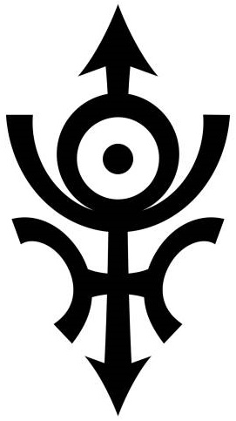
Projections
Constructing the Anunnaki Systems
Paul McKay Easter
Fairbanks, AK
paul.m.easter@gmail.com
972-474-7501
Archaeological Renaissance: Part III

Slide 2
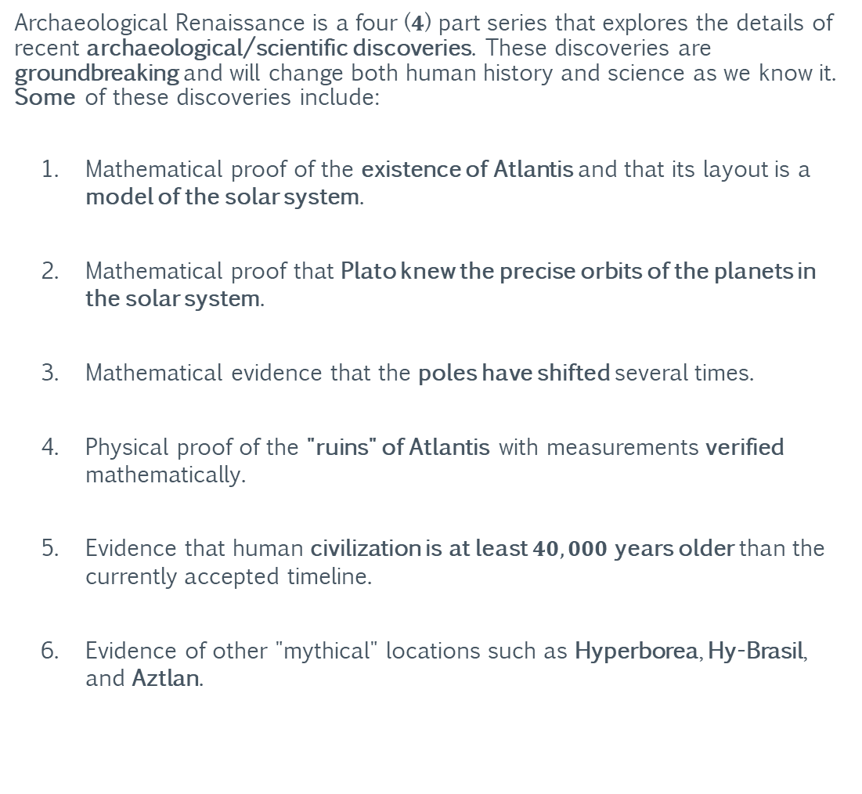
Archaeological Renaissance
Summary
Archaeological Renaissance is a four ($4$) part series that explores the details of recent archaeological/scientific discoveries. These discoveries are groundbreaking and will change both human history and science as we know it. Some of these discoveries include:
Mathematical proof of the existence of Atlantis and that its layout is a model of the solar system.
Mathematical proof that Plato knew the precise orbits of the planets in the solar system.
Mathematical evidence that the poles have shifted several times.
Physical proof of the "ruins" of Atlantis with measurements verified mathematically.
Evidence that human civilization is at least $40,000$years older than the currently accepted timeline.
Evidence of other "mythical" locations such as Hyperborea, Hy-Brasil, and Aztlan.
Part I: Ants
Part II: Pivots
Part III: Projections
Part IV: Frames

Slide 3
Archaeological Renaissance
This Information Shall Remain Free
Grant of Public License
This document is part of a software program. The software program, which includes its documentation, is free: you can redistribute it and/or modify it under the terms of the GNU General Public License as published by the Free Software Foundation, either version 3 of the License, or (at your option) any later version.
This program is distributed in the hope that it will be useful, but without any warranty; without even the implied warranty of merchantability or fitness for a particular purpose. See the GNU General Public License for more details.
You should have received a copy of the GNU General Public License along with this program. If not, see https://www.gnu.org/licenses/.
Part I: Ants
Part II: Pivots
Part III: Projections
Part IV: Frames

Slide 4
Archaeological Renaissance
This Information Shall Remain Free
Grant of Current and Future Patents
All rights to any current and future patents, having derived from any quantity of unique and/or proprietary information contained within the software program, generated by the software program, or derived from the use and/or reverse engineering of the software program are reserved.
All reserved rights of said patents are hereby granted to the public.
Image Copyrights
Some images used in this document were acquired through a public image search engine and their use is covered under United States “fair use” laws for academic/non-commercial distribution. However, some images may be subject to additional copyright(s) and/or commercial redistribution restrictions.
Part I: Ants
Part II: Pivots
Part III: Projections
Part IV: Frames
https://www.dmlp.org/legal-guide/fair-use

Slide 5
For Elaina, Collin, and Arianna: This lost world I’ve found; I rebuild for you.
-Dad

Slide 6
Section I: Arrayed with the Sun
The following section examines the properties of the solar system in its current state. This includes the size (circumference) and orbital radius of the “primary” objects of the solar system.

Slide 7
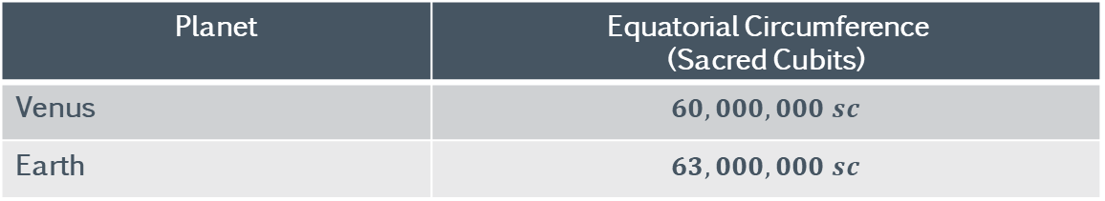
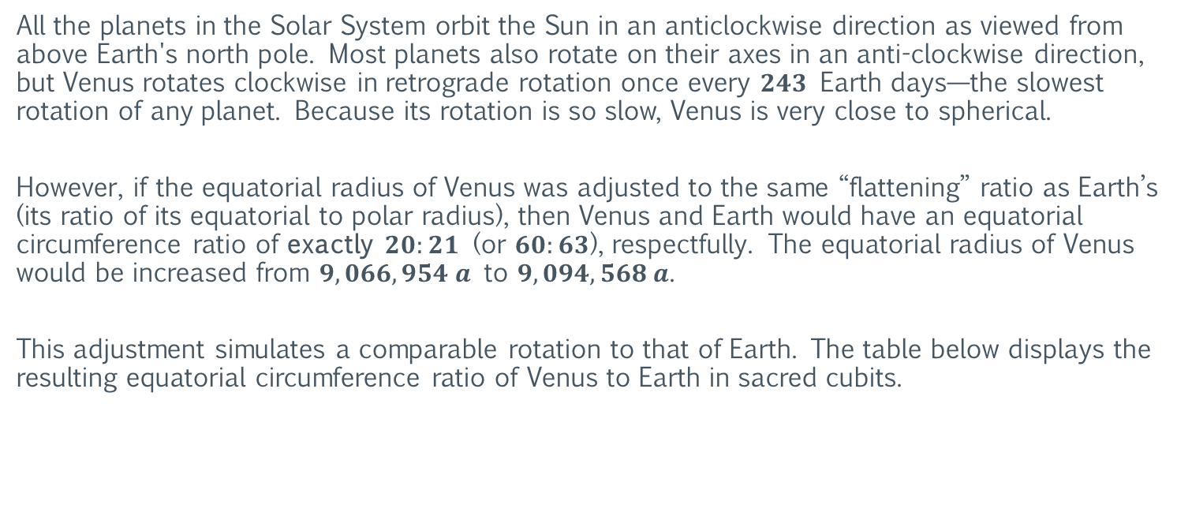
Arrayed with the Sun
Venus: Equatorial Circumference
All the planets in the Solar System orbit the Sun in an anticlockwise direction as viewed from above Earth's north pole. Most planets also rotate on their axes in an anti-clockwise direction, but Venus rotates clockwise in retrograde rotation once every $243$ Earth days—the slowest rotation of any planet. Because its rotation is so slow, Venus is very close to spherical.
However, if the equatorial radius of Venus was adjusted to the same “flattening” ratio as Earth’s (its ratio of its equatorial to polar radius), then Venus and Earth would have an equatorial circumference ratio of exactly $20:21$ (or $60:63$), respectfully. The equatorial radius of Venus would be increased from $9,066,954 a$ to $9,094,568 a$.
This adjustment simulates a comparable rotation to that of Earth. The table below displays the resulting equatorial circumference ratio of Venus to Earth in sacred cubits.
Planet | Equatorial Circumference (Sacred Cubits)
Venus | $$60,000,000 sc$$
Earth | $$63,000,000 sc$$
https://en.wikipedia.org/wiki/Venus

Slide 8
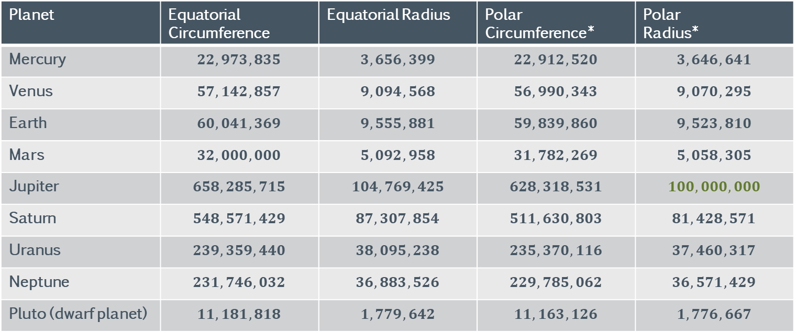
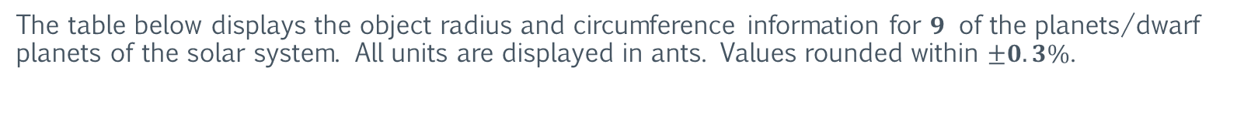
Arrayed with the Sun
The Usual Suspects
The table below displays the object radius and circumference information for $9$ of the planets/dwarf planets of the solar system. All units are displayed in ants. Values rounded within $±0.3\%$.
Planet | Equatorial Circumference | Equatorial Radius | Polar Circumference* | Polar Radius*
Mercury | $$22,973,835$$ | $$3,656,399$$ | $$22,912,520$$ | $$3,646,641$$
Venus | $$57,142,857$$ | $$9,094,568$$ | $$56,990,343$$ | $$9,070,295$$
Earth | $$60,041,369$$ | $$9,555,881$$ | $$59,839,860$$ | $$9,523,810$$
Mars | $$32,000,000$$ | $$5,092,958$$ | $$31,782,269$$ | $$5,058,305$$
Jupiter | $$658,285,715$$ | $$104,769,425$$ | $$628,318,531$$ | $$100,000,000$$
Saturn | $$548,571,429$$ | $$87,307,854$$ | $$511,630,803$$ | $$81,428,571$$
Uranus | $$239,359,440$$ | $$38,095,238$$ | $$235,370,116$$ | $$37,460,317$$
Neptune | $$231,746,032$$ | $$36,883,526$$ | $$229,785,062$$ | $$36,571,429$$
Pluto (dwarf planet) | $$11,181,818$$ | $$1,779,642$$ | $$11,163,126$$ | $$1,776,667$$
*Represents the virtual polar radius and circumference.

Slide 9
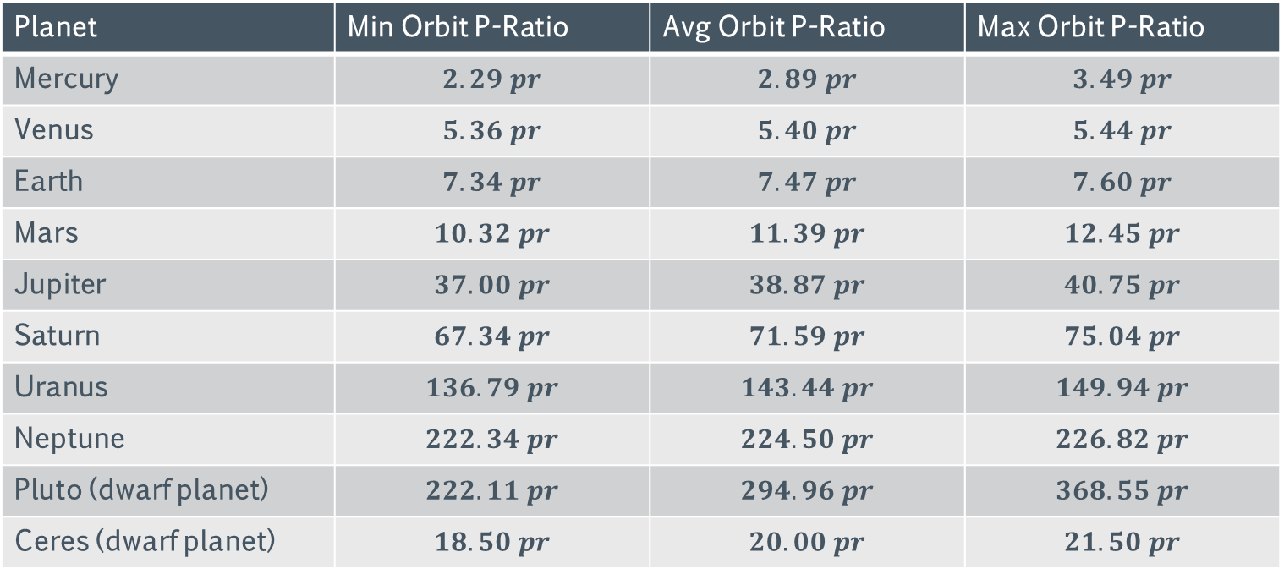
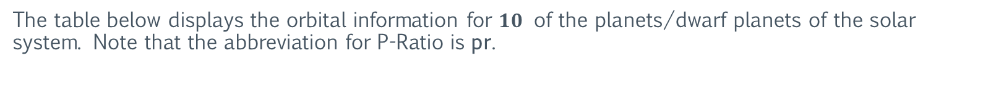
Arrayed with the Sun
The Usual Suspects (and Ceres)
The table below displays the orbital information for $10$ of the planets/dwarf planets of the solar system. Note that the abbreviation for P-Ratio is pr.
Planet | Min Orbit P-Ratio | Avg Orbit P-Ratio | Max Orbit P-Ratio
Mercury | $$2.29 pr$$ | $$2.89 pr$$ | $$3.49 pr$$
Venus | $$5.36 pr$$ | $$5.40 pr$$ | $$5.44 pr$$
Earth | $$7.34 pr$$ | $$7.47 pr$$ | $$7.60 pr$$
Mars | $$10.32 pr$$ | $$11.39 pr$$ | $$12.45 pr$$
Jupiter | $$37.00 pr$$ | $$38.87 pr$$ | $$40.75 pr$$
Saturn | $$67.34 pr$$ | $$71.59 pr$$ | $$75.04 pr$$
Uranus | $$136.79 pr$$ | $$143.44 pr$$ | $$149.94 pr$$
Neptune | $$222.34 pr$$ | $$224.50 pr$$ | $$226.82 pr$$
Pluto (dwarf planet) | $$222.11 pr$$ | $$294.96 pr$$ | $$368.55 pr$$
Ceres (dwarf planet) | $$18.50 pr$$ | $$20.00 pr$$ | $$21.50 pr$$

Slide 10
Arrayed with the Sun
The Moon
The table below displays the object orbit, radius, and circumference information for Earth’s moon. All units are displayed in ants.
Object | Orbital Radius | Equatorial Circumference | Equatorial Radius | Polar Circumference* | Polar Radius*
Moon (Luna) | $$576,000,000$$ | $$16,363,636$$ | $$2,604,354$$ | $$16,336,282$$ | $$2,600,000$$
*Represents the virtual polar radius and circumference.

Slide 11
Arrayed with the Sun
Ceres
The table below displays the object orbit, radius, and circumference information for the dwarf planet Ceres. All units are displayed in ants.
Object | Orbital Radius (avg) | Circumference | Radius
Ceres | ~$600,000,000,000$ | $$4,451,000$$ | $$708,399$$
https://en.wikipedia.org/wiki/Ceres_(dwarf_planet)

Slide 12
Arrayed with the Sun
Solar System Equatorial Radius Ratios: Reference
Object | Sun | Mercury | Venus | Earth | Moon | Mars | Jupiter | Saturn | Uranus | Neptune | Pluto | Ceres
Sun | 1 | 284.9090 | 114.5454 | 109.0909 | 400.0000 | 204.5454 | 9.94318 | 11.93182 | 27.27273 | 28.40909 | 585.4545 | 1,480.0000
Mercury | 0.00351 | 1 | 0.40204 | 0.38290 | 1.40396 | 0.71793 | 0.03490 | 0.04188 | 0.09572 | 0.09971 | 2.05488 | 5.19464
Venus | 0.00873 | 2.48730 | 1 | 0.95238 | 3.49206 | 1.78571 | 0.08681 | 0.10417 | 0.23810 | 0.24802 | 5.1111 | 12.92063
Earth | 0.00917 | 2.61167 | 1.0500 | 1 | 3.6667 | 1.8750 | 0.09115 | 0.10937 | 0.2500 | 0.26042 | 5.3667 | 13.5667
Moon | 0.00250 | 0.71227 | 0.28636 | 0.2727 | 1 | 0.51136 | 0.02486 | 0.02983 | 0.06818 | 0.07102 | 1.46364 | 3.7000
Mars | 0.00489 | 1.39289 | 0.5600 | 0.5333 | 1.95556 | 1 | 0.04861 | 0.05833 | 0.1333 | 0.13889 | 2.86222 | 7.23556
Jupiter | 0.10057 | 28.65371 | 11.5200 | 10.97143 | 40.22857 | 20.57143 | 1 | 1.20000 | 2.74286 | 2.85714 | 58.8800 | 148.84571
Saturn | 0.08381 | 23.87810 | 9.6000 | 9.14286 | 33.52381 | 17.14286 | 0.8333 | 1 | 2.28571 | 2.38095 | 49.0667 | 124.03810
Uranus | 0.03667 | 10.44667 | 4.2000 | 4.0000 | 14.6667 | 7.5000 | 0.36458 | 0.43750 | 1 | 1.04167 | 21.46667 | 54.2667
Neptune | 0.03520 | 10.02880 | 4.0320 | 3.8400 | 14.0800 | 7.2000 | 0.3500 | 0.4200 | 0.9600 | 1 | 20.6080 | 52.0960
Pluto | 0.00171 | 0.48665 | 0.19565 | 0.18634 | 0.68323 | 0.34938 | 0.01698 | 0.02038 | 0.04658 | 0.04852 | 1 | 2.52795
Ceres | 0.00068 | 0.19251 | 0.07740 | 0.07371 | 0.27027 | 0.13821 | 0.00672 | 0.00806 | 0.01843 | 0.01920 | 0.39558 | 1

Slide 13
Section II: Measurement Systems
The following section examines various measurement systems. These include the antediluvian systems, the sexagesimal number system, the Mesopotamian deities (numbers), and others. The purpose is to identify patterns and similarities between measurement systems as well as infer the origins of ancient measurement systems (as well as systems currently in use).

Slide 14
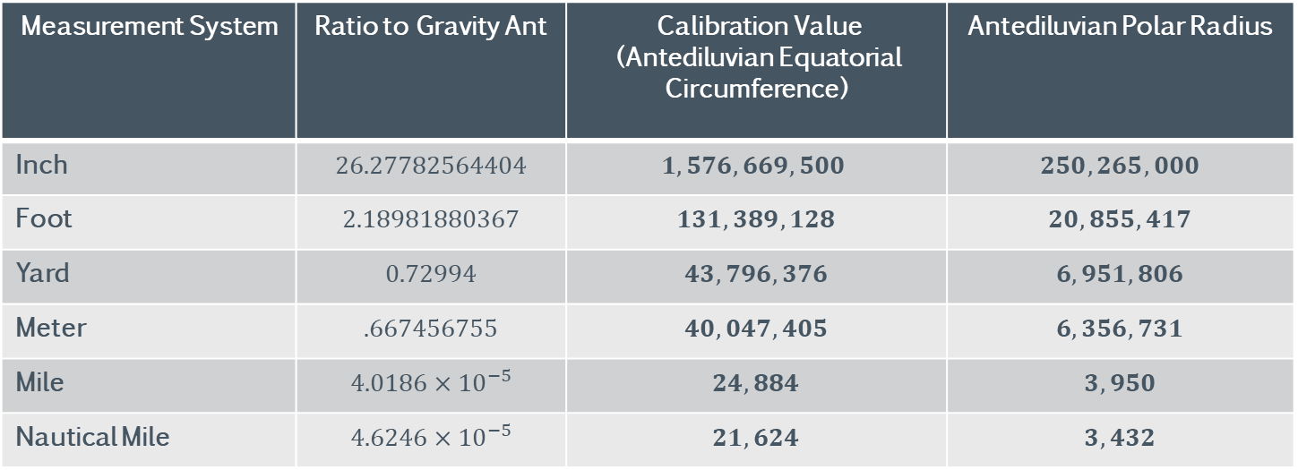
Measurement Systems
Standard Systems
The table below displays the calibration values for standard/common measurement systems.
Measurement System | Ratio to Gravity Ant | Calibration Value (Antediluvian Equatorial Circumference) | Antediluvian Polar Radius
Inch | $$26.27782564404$$ | $$1,576,669,500$$ | $$250,265,000$$
Foot | $$2.18981880367$$ | $$131,389,128$$ | $$20,855,417$$
Yard | $$0.72994$$ | $$43,796,376$$ | $$6,951,806$$
Meter | $$.667456755$$ | $$40,047,405$$ | $$6,356,731$$
Mile | $$4.0186×{10}^{−5}$$ | $$24,884$$ | $$3,950$$
Nautical Mile | $$4.6246×{10}^{−5}$$ | $$21,624$$ | $$3,432$$

Slide 15
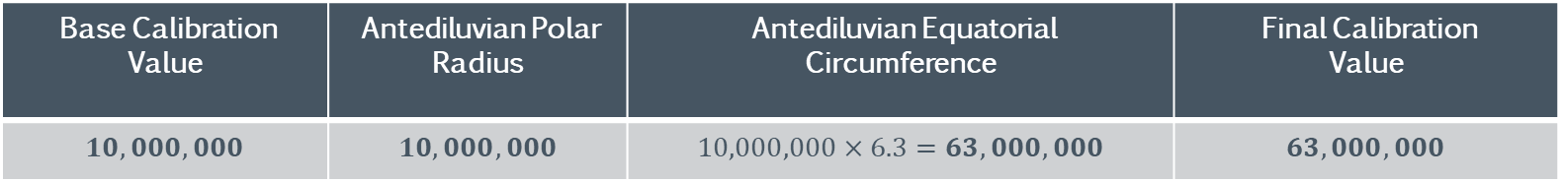
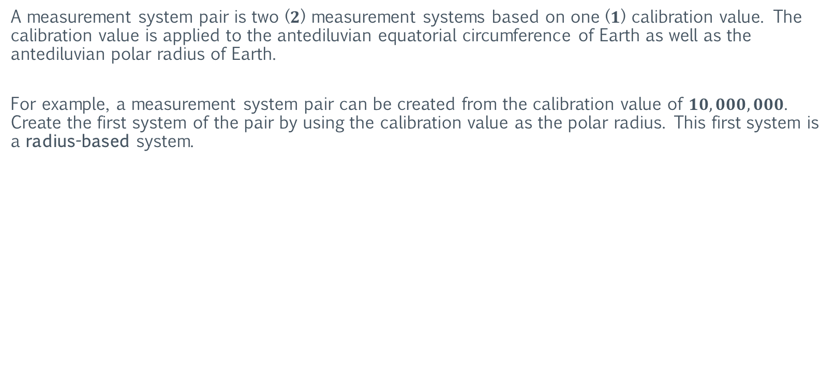
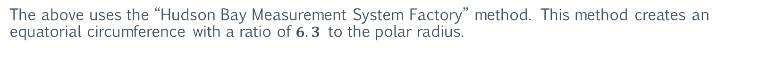
Measurement Systems
Measurement System Pairs
A measurement system pair is two ($2$) measurement systems based on one ($1$) calibration value. The calibration value is applied to the antediluvian equatorial circumference of Earth as well as the antediluvian polar radius of Earth.
For example, a measurement system pair can be created from the calibration value of $10,000,000$. Create the first system of the pair by using the calibration value as the polar radius. This first system is a radius-based system.
Base Calibration Value | Antediluvian Polar Radius | Antediluvian Equatorial Circumference | Final Calibration Value
$$10,000,000$$ | $$10,000,000$$ | $$10,000,000×6.3=63,000,000$$ | $$63,000,000$$
The above uses the “Hudson Bay Measurement System Factory” method. This method creates an equatorial circumference with a ratio of $6.3$ to the polar radius.

Slide 16
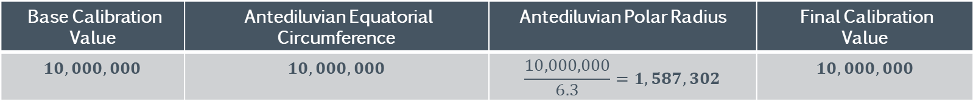
Measurement Systems
Measurement System Pairs
Create the second system of the pair by using the calibration value as the equatorial circumference. This second system is a circumference-based system.
Base Calibration Value | Antediluvian Equatorial Circumference | Antediluvian Polar Radius | Final Calibration Value
$$10,000,000$$ | $$10,000,000$$ | $$\frac{10,000,000}{6.3}=1,587,302$$ | $$10,000,000$$
Note that the final calibration value is equal to the equatorial circumference of the system.

Slide 17

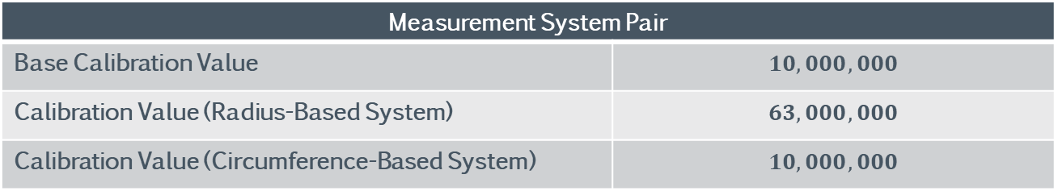
Measurement Systems
Measurement System Pairs
The table below displays the information for the newly created measurement system pair.
Measurement System Pair | Antediluvian Polar Radius
Base Calibration Value | $$10,000,000$$
Calibration Value (Radius-Based System) | $$63,000,000$$
Calibration Value (Circumference-Based System) | $$10,000,000$$
Note that the radius-based system represents the sacred cubit ($63,000,000$).

Slide 18
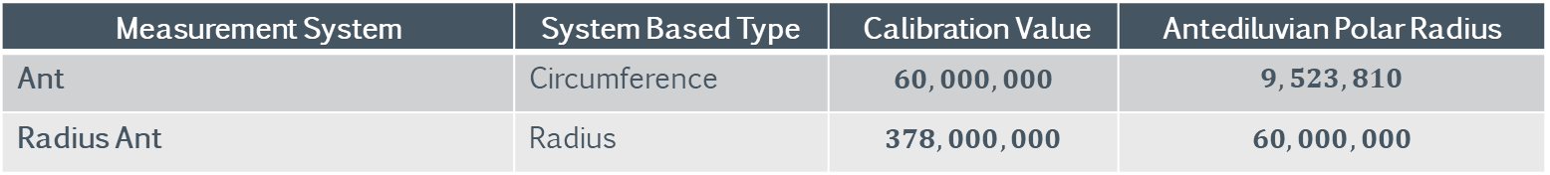
Measurement Systems
Antediluvian Systems Pairs
The table below displays the calibration values for the measurement system pair of the ant.
Measurement System | System Based Type | Calibration Value | Antediluvian Polar Radius
Ant | Circumference | $$60,000,000$$ | $$9,523,810$$
Radius Ant | Radius | $$378,000,000$$ | $$60,000,000$$

Slide 19
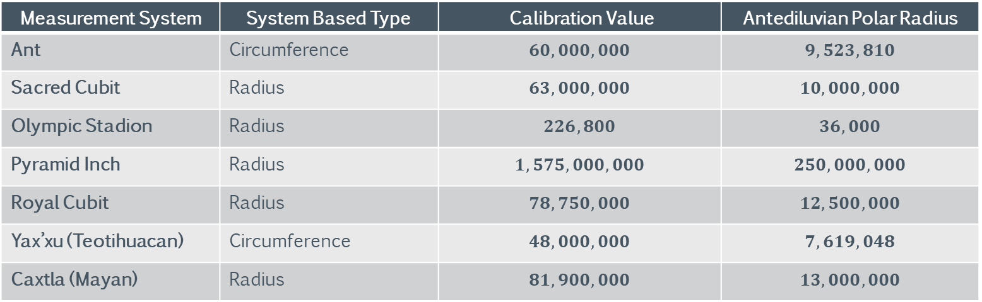
Measurement Systems
Antediluvian Systems
The table below displays the calibration values for antediluvian measurement systems.
Measurement System | System Based Type | Calibration Value | Antediluvian Polar Radius
Ant | Circumference | $$60,000,000$$ | $$9,523,810$$
Sacred Cubit | Radius | $$63,000,000$$ | $$10,000,000$$
Olympic Stadion | Radius | $$226,800$$ | $$36,000$$
Pyramid Inch | Radius | $$1,575,000,000$$ | $$250,000,000$$
Royal Cubit | Radius | $$78,750,000$$ | $$12,500,000$$
Yax’xu (Teotihuacan) | $$\text{Circumference}$$ | $$48,000,000$$ | $$7,619,048$$
Caxtla (Mayan) | $$\text{Radius}$$ | $$81,900,000$$ | $$13,000,000$$

Slide 20
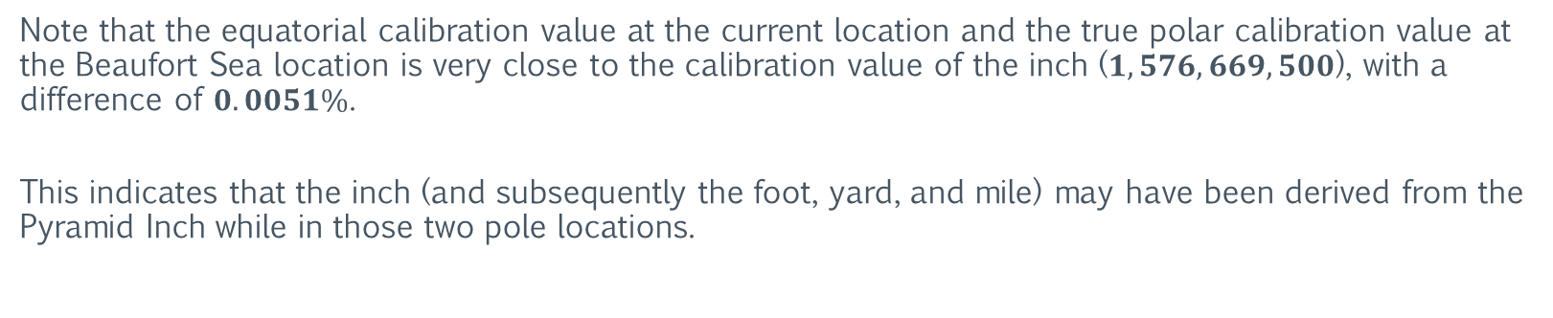
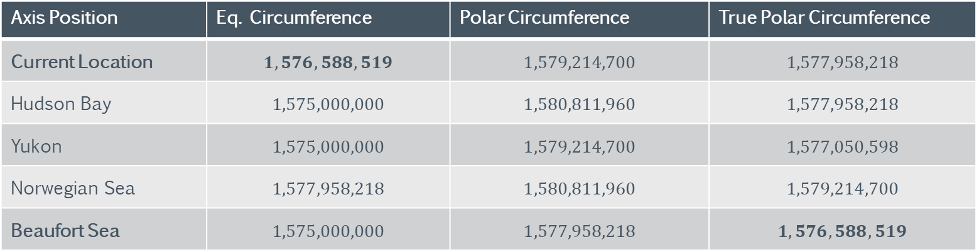
Measurement Systems
Antediluvian Systems
The table below shows the calibration values of the Pyramid Inch in the five different pole locations (axis positions).
Axis Position | Eq. Circumference | Polar Circumference | True Polar Circumference
Current Location | $$1,576,588,519$$ | $$1,579,214,700$$ | $$1,577,958,218$$
Hudson Bay | $$1,575,000,000$$ | $$1,580,811,960$$ | $$1,577,958,218$$
Yukon | $$1,575,000,000$$ | $$1,579,214,700$$ | $$1,577,050,598$$
Norwegian Sea | $$1,577,958,218$$ | $$1,580,811,960$$ | $$1,579,214,700$$
Beaufort Sea | $$1,575,000,000$$ | $$1,577,958,218$$ | $$1,576,588,519$$
Note that the equatorial calibration value at the current location and the true polar calibration value at the Beaufort Sea location is very close to the calibration value of the inch ($1,576,669,500$), with a difference of $0.0051\%$.
This indicates that the inch (and subsequently the foot, yard, and mile) may have been derived from the Pyramid Inch while in those two pole locations.

Slide 21
Measurement Systems
Antediluvian Systems: The Yax’xu
The Yax’xu, which derives its name from the Mayan language for “blue ant”, is the base unit of length used at the archaeological site of Teotihuacan, Mexico.
The table below displays the details of the Yax’xu.
Measurement System | System Based Type | Calibration Value | Antediluvian Polar Radius
Yax’xu ($y$) | Circumference | $$48,000,000$$ | $$7,619,048$$
https://news.asu.edu/content/asu-archaeologist-determines-standard-unit-measurement-ancient-mesoamerican-city

Slide 22
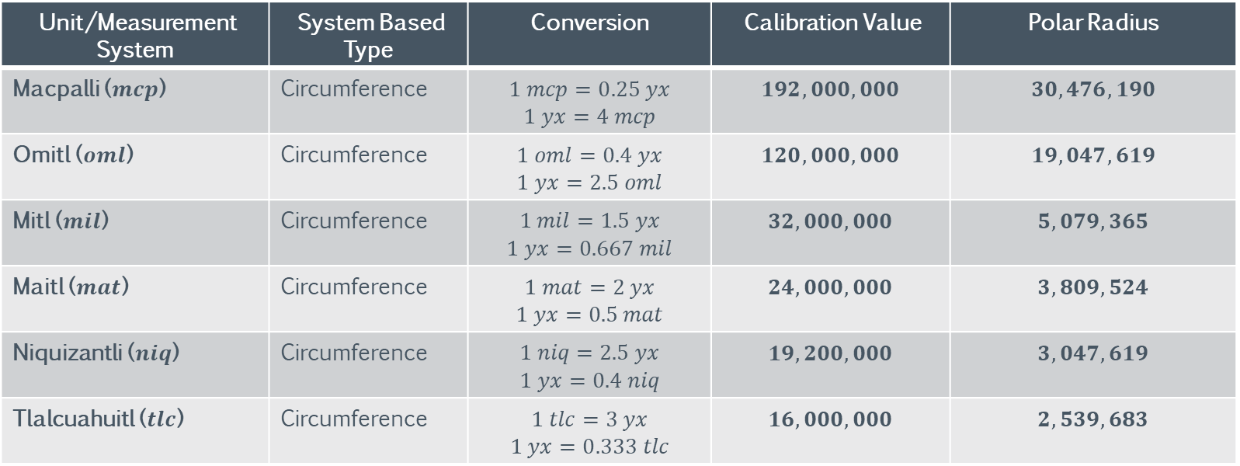
Measurement Systems
Antediluvian Systems: The Yax’xu
There are several systems based on the Yax’xu (and vice-versa). The table below displays the details of these measurement systems. Note that all systems are circumference-based.
Unit/Measurement System | System Based Type | Conversion | Calibration Value | Polar Radius
Macpalli ($mcp$) | Circumference | $$1 mcp=0.25 yx$$ $$1 yx=4 mcp$$ | $$192,000,000$$ | $$30,476,190$$
Omitl ($oml$) | Circumference | $$1 oml=0.4 yx$$ $$1 yx=2.5 oml$$ | $$120,000,000$$ | $$19,047,619$$
Mitl ($mil$) | Circumference | $$1 mil=1.5 yx$$ $$1 yx=0.667 mil$$ | $$32,000,000$$ | $$5,079,365$$
Maitl ($mat$) | Circumference | $$1 mat=2 yx$$ $$1 yx=0.5 mat$$ | $$24,000,000$$ | $$3,809,524$$
Niquizantli ($niq$) | Circumference | $$1 niq=2.5 yx$$ $$1 yx=0.4 niq$$ | $$19,200,000$$ | $$3,047,619$$
Tlalcuahuitl ($tlc$) | Circumference | $$1 tlc=3 yx$$ $$1 yx=0.333 tlc$$ | $$16,000,000$$ | $$2,539,683$$
https://es.wikipedia.org/wiki/Sistema_m%C3%A9trico_mexica#Teotihuac%C3%A1n

Slide 23
Measurement Systems
Antediluvian Systems: The Caxtla
The Caxtla, which derives its name from the archaeological site of Cacaxtla, Mexico is a base unit of length used at this and other Mayan/Mesoamerican sites. The measurements are based on the research of the anthropologist, Genevieve Lucet (and others).
The table below displays the details of the Caxtla.
Measurement System | System Based Type | Calibration Value | Antediluvian Polar Radius
Caxtla ($cx$) | Radius | $$81,900,000$$ | $$13,000,000$$
Dimensioning_at_the_Epiclassic_site_of_Cacaxtla_Tlaxcala_M%C3%A9xico_An_Expression_of_Pan-Mesoamerican_Complex_Thinking

Slide 24
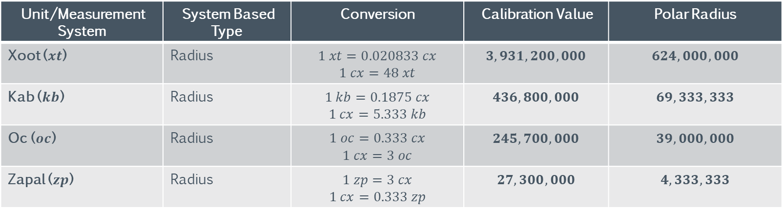
Measurement Systems
Antediluvian Systems: The Caxtla
There are several systems based on the Caxtla (and vice-versa). The table below displays the details of these measurement systems. Note that all systems are radius-based.
Unit/Measurement System | System Based Type | Conversion | Calibration Value | Polar Radius
Xoot ($xt$) | Radius | $$1 xt=0.020833 cx$$ $$1 cx=48 xt$$ | $$3,931,200,000$$ | $$624,000,000$$
Kab ($kb$) | Radius | $$1 kb=0.1875 cx$$ $$1 cx=5.333 kb$$ | $$436,800,000$$ | $$69,333,333$$
Oc ($oc$) | Radius | $$1 oc=0.333 cx$$ $$1 cx=3 oc$$ | $$245,700,000$$ | $$39,000,000$$
Zapal ($zp$) | Radius | $$1 zp=3 cx$$ $$1 cx=0.333 zp$$ | $$27,300,000$$ | $$4,333,333$$
https://es.wikipedia.org/wiki/Sistema_m%C3%A9trico_mexica#Teotihuac%C3%A1n

Slide 25
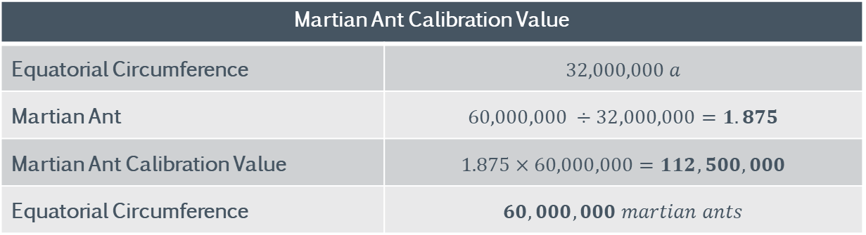
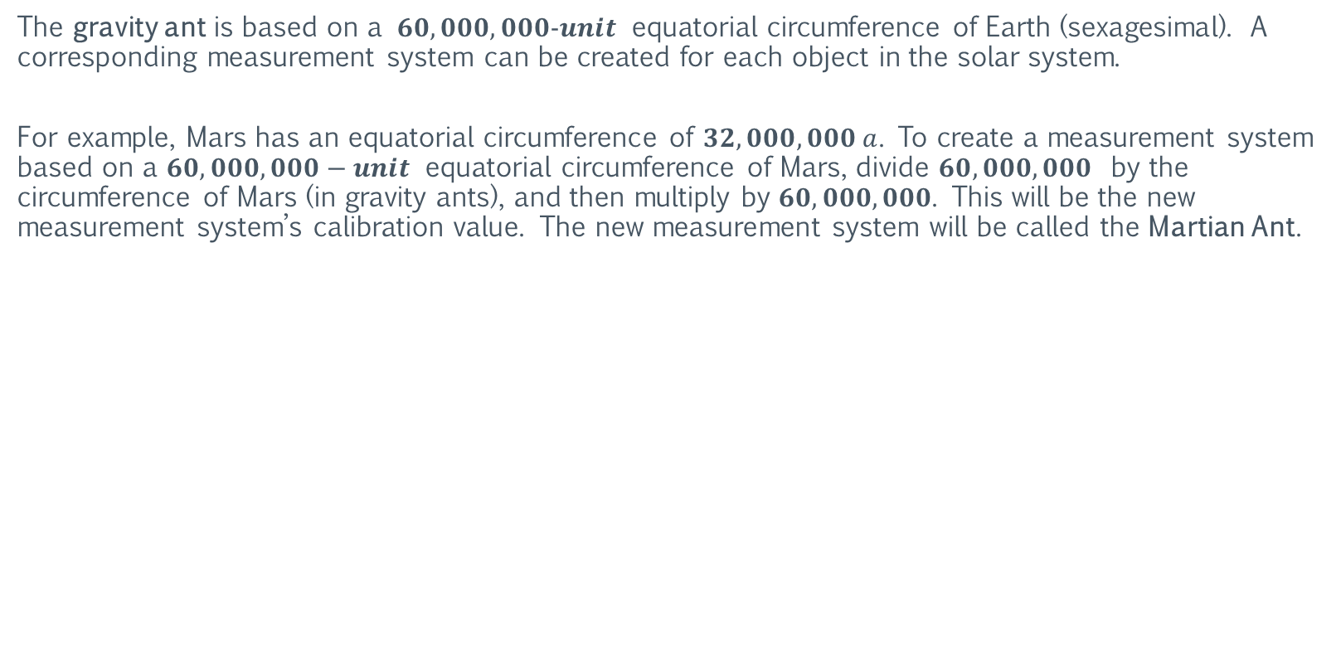
Measurement Systems
The Sexagesimal Systems
The gravity ant is based on a $60,000,000−unit$ equatorial circumference of Earth (sexagesimal). A corresponding measurement system can be created for each object in the solar system.
For example, Mars has an equatorial circumference of $32,000,000 a$. To create a measurement system based on a $60,000,000−unit$ equatorial circumference of Mars, divide $60,000,000$ by the circumference of Mars (in gravity ants), and then multiply by $60,000,000$. This will be the new measurement system’s calibration value. The new measurement system will be called the Martian Ant.
Martian Ant Calibration Value | Speed of Light Value ($c$)
Equatorial Circumference | $$32,000,000 a$$
Martian Ant | $$60,000,000 ÷32,000,000=1.875$$
Martian Ant Calibration Value | $$1.875×60,000,000=112,500,000$$
Equatorial Circumference | $$60,000,000 martian ants$$

Slide 26
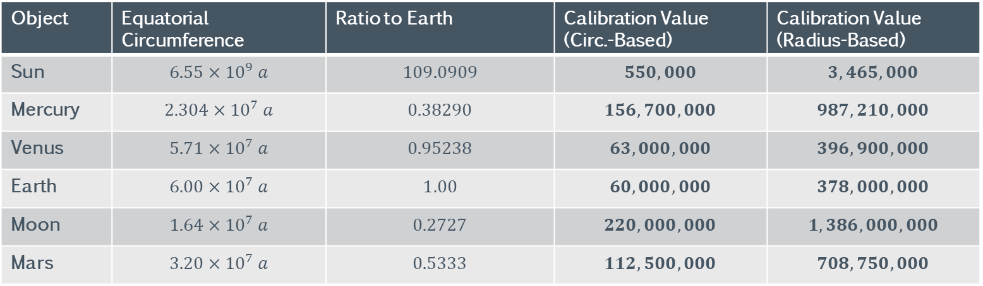
Measurement Systems
The Sexagesimal Systems
The table below displays the calibration values for the inner objects of the solar system as well as the Sun and Moon.
Object | Equatorial Circumference | Ratio to Earth | Calibration Value (Circ.-Based) | Calibration Value (Radius-Based)
Sun | $$6.55×{10}^{9} a$$ | $$109.0909$$ | $$550,000$$ | $$3,465,000$$
Mercury | $$2.304×{10}^{7} a$$ | $$0.38290$$ | $$156,700,000$$ | $$987,210,000$$
Venus | $$5.71×{10}^{7} a$$ | $$0.95238$$ | $$63,000,000$$ | $$396,900,000$$
Earth | $$6.00×{10}^{7} a$$ | $$1.00$$ | $$60,000,000$$ | $$378,000,000$$
Moon | $$1.64×{10}^{7} a$$ | $$0.2727$$ | $$220,000,000$$ | $$1,386,000,000$$
Mars | $$3.20×{10}^{7} a$$ | $$0.5333$$ | $$112,500,000$$ | $$708,750,000$$

Slide 27
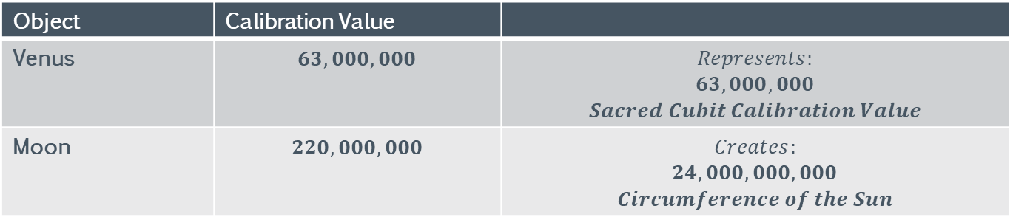
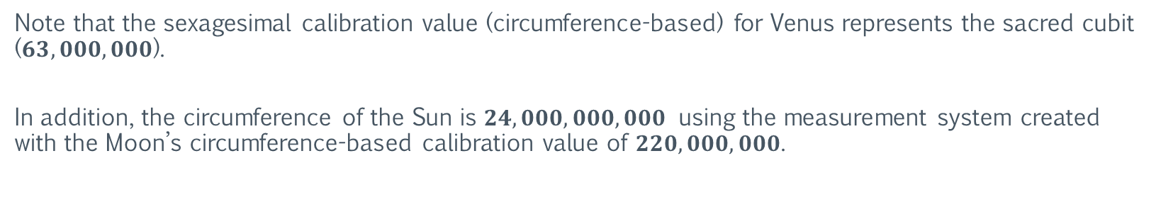
Measurement Systems
The Sexagesimal Systems
Note that the sexagesimal calibration value (circumference-based) for Venus represents the sacred cubit ($63,000,000$).
In addition, the circumference of the Sun is $24,000,000,000$ using the measurement system created with the Moon’s circumference-based calibration value of $220,000,000$.
Object | Calibration Value
Venus | $$63,000,000$$ | $$Represents:$$ $$63,000,000$$ $$Sacred Cubit Calibration Value$$
Moon | $$220,000,000$$ | $$Creates:$$ $$24,000,000,000$$ $$Circumference of the Sun$$

Slide 28
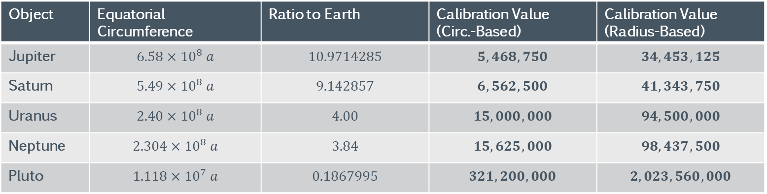
Measurement Systems
The Sexagesimal Systems
The table below displays the sexagesimal calibration values for the outer planets of the solar system as well as the dwarf planet Pluto.
Object | Equatorial Circumference | Ratio to Earth | Calibration Value (Circ.-Based) | Calibration Value (Radius-Based)
Jupiter | $$6.58×{10}^{8} a$$ | $$10.9714285$$ | $$5,468,750$$ | $$34,453,125$$
Saturn | $$5.49×{10}^{8} a$$ | $$9.142857$$ | $$6,562,500$$ | $$41,343,750$$
Uranus | $$2.40×{10}^{8} a$$ | $$4.00$$ | $$15,000,000$$ | $$94,500,000$$
Neptune | $$2.304×{10}^{8} a$$ | $$3.84$$ | $$15,625,000$$ | $$98,437,500$$
Pluto | $$1.118×{10}^{7} a$$ | $$0.1867995$$ | $$321,200,000$$ | $$2,023,560,000$$

Slide 29
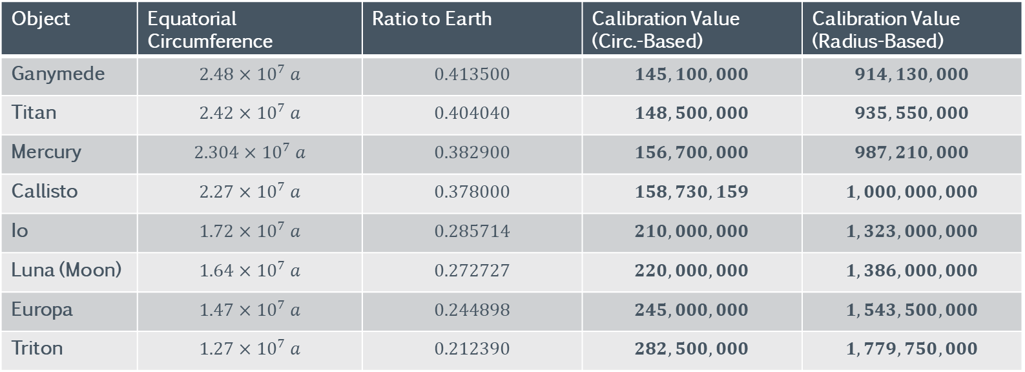
Measurement Systems
The Sexagesimal Systems: Moons & Dwarf Planets
The table below displays the sexagesimal calibration values for the largest solar system moons & dwarf planets.
Object | Equatorial Circumference | Ratio to Earth | Calibration Value (Circ.-Based) | Calibration Value (Radius-Based)
Ganymede | $$2.48×{10}^{7} a$$ | $$0.413500$$ | $$145,100,000$$ | $$914,130,000$$
Titan | $$2.42×{10}^{7} a$$ | $$0.404040$$ | $$148,500,000$$ | $$935,550,000$$
Mercury | $$2.304×{10}^{7} a$$ | $$0.382900$$ | $$156,700,000$$ | $$987,210,000$$
Callisto | $$2.27×{10}^{7} a$$ | $$0.378000$$ | $$158,730,159$$ | $$1,000,000,000$$
Io | $$1.72×{10}^{7} a$$ | $$0.285714$$ | $$210,000,000$$ | $$1,323,000,000$$
Luna (Moon) | $$1.64×{10}^{7} a$$ | $$0.272727$$ | $$220,000,000$$ | $$1,386,000,000$$
Europa | $$1.47×{10}^{7} a$$ | $$0.244898$$ | $$245,000,000$$ | $$1,543,500,000$$
Triton | $$1.27×{10}^{7} a$$ | $$0.212390$$ | $$282,500,000$$ | $$1,779,750,000$$

Slide 30
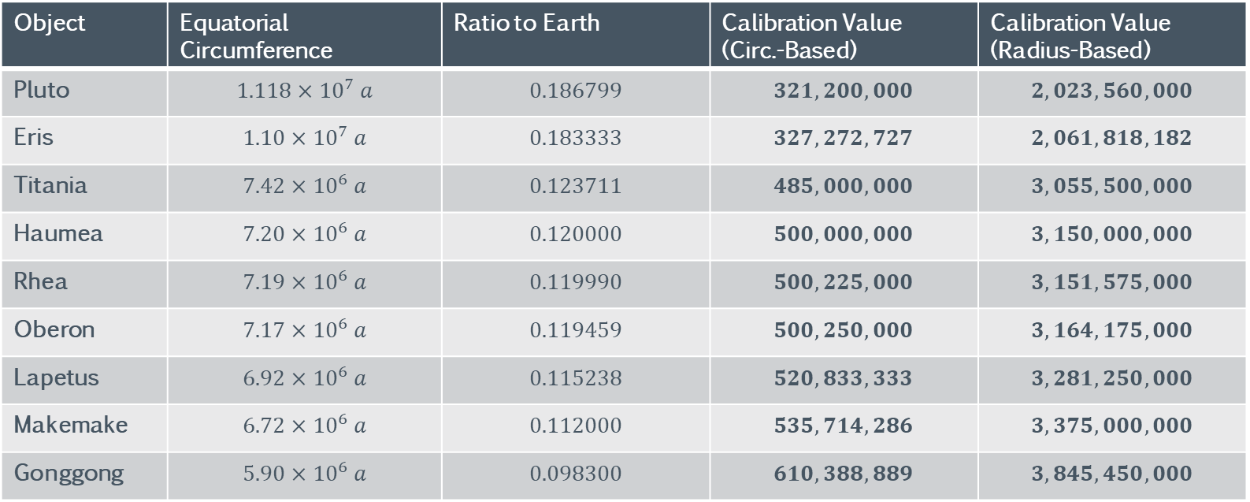
Measurement Systems
The Sexagesimal Systems: Moons & Dwarf Planets
The table below displays the sexagesimal calibration values for the largest solar system moons & dwarf planets.
Object | Equatorial Circumference | Ratio to Earth | Calibration Value (Circ.-Based) | Calibration Value (Radius-Based)
Pluto | $$1.118×{10}^{7} a$$ | $$0.186799$$ | $$321,200,000$$ | $$2,023,560,000$$
Eris | $$1.10×{10}^{7} a$$ | $$0.183333$$ | $$327,272,727$$ | $$2,061,818,182$$
Titania | $$7.42×{10}^{6} a$$ | $$0.123711$$ | $$485,000,000$$ | $$3,055,500,000$$
Haumea | $$7.20×{10}^{6} a$$ | $$0.120000$$ | $$500,000,000$$ | $$3,150,000,000$$
Rhea | $$7.19×{10}^{6} a$$ | $$0.119990$$ | $$500,225,000$$ | $$3,151,575,000$$
Oberon | $$7.17×{10}^{6} a$$ | $$0.119459$$ | $$500,250,000$$ | $$3,164,175,000$$
Lapetus | $$6.92×{10}^{6} a$$ | $$0.115238$$ | $$520,833,333$$ | $$3,281,250,000$$
Makemake | $$6.72×{10}^{6} a$$ | $$0.112000$$ | $$535,714,286$$ | $$3,375,000,000$$
Gonggong | $$5.90×{10}^{6} a$$ | $$0.098300$$ | $$610,388,889$$ | $$3,845,450,000$$

Slide 31
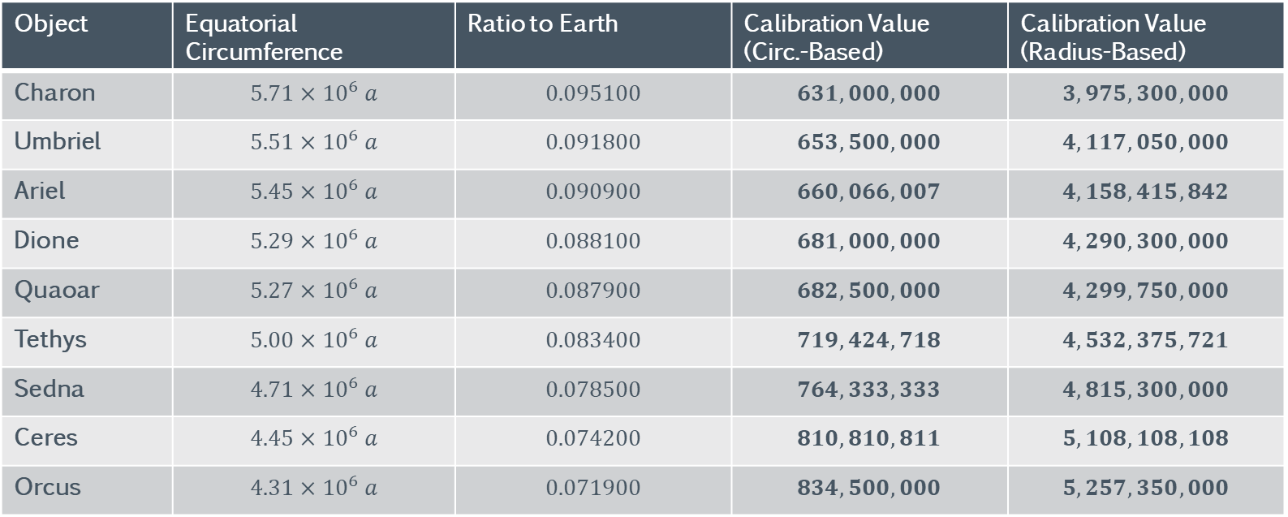
Measurement Systems
The Sexagesimal Systems: Moons & Dwarf Planets
The table below displays the sexagesimal calibration values for the largest solar system moons & dwarf planets.
Object | Equatorial Circumference | Ratio to Earth | Calibration Value (Circ.-Based) | Calibration Value (Radius-Based)
Charon | $$5.71×{10}^{6} a$$ | $$0.095100$$ | $$631,000,000$$ | $$3,975,300,000$$
Umbriel | $$5.51×{10}^{6} a$$ | $$0.091800$$ | $$653,500,000$$ | $$4,117,050,000$$
Ariel | $$5.45×{10}^{6} a$$ | $$0.090900$$ | $$660,066,007$$ | $$4,158,415,842$$
Dione | $$5.29×{10}^{6} a$$ | $$0.088100$$ | $$681,000,000$$ | $$4,290,300,000$$
Quaoar | $$5.27×{10}^{6} a$$ | $$0.087900$$ | $$682,500,000$$ | $$4,299,750,000$$
Tethys | $$5.00×{10}^{6} a$$ | $$0.083400$$ | $$719,424,718$$ | $$4,532,375,721$$
Sedna | $$4.71×{10}^{6} a$$ | $$0.078500$$ | $$764,333,333$$ | $$4,815,300,000$$
Ceres | $$4.45×{10}^{6} a$$ | $$0.074200$$ | $$810,810,811$$ | $$5,108,108,108$$
Orcus | $$4.31×{10}^{6} a$$ | $$0.071900$$ | $$834,500,000$$ | $$5,257,350,000$$

Slide 32
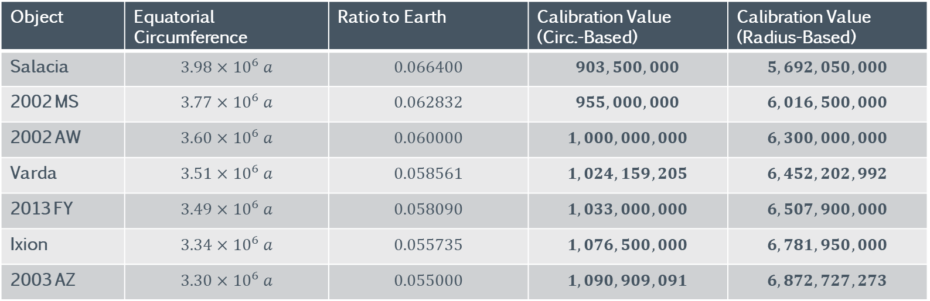
Measurement Systems
The Sexagesimal Systems: Moons & Dwarf Planets
The table below displays the sexagesimal calibration values for the largest solar system moons & dwarf planets.
Object | Equatorial Circumference | Ratio to Earth | Calibration Value (Circ.-Based) | Calibration Value (Radius-Based)
Salacia | $$3.98×{10}^{6} a$$ | $$0.066400$$ | $$903,500,000$$ | $$5,692,050,000$$
2002 MS | $$3.77×{10}^{6} a$$ | $$0.062832$$ | $$955,000,000$$ | $$6,016,500,000$$
2002 AW | $$3.60×{10}^{6} a$$ | $$0.060000$$ | $$1,000,000,000$$ | $$6,300,000,000$$
Varda | $$3.51×{10}^{6} a$$ | $$0.058561$$ | $$1,024,159,205$$ | $$6,452,202,992$$
2013 FY | $$3.49×{10}^{6} a$$ | $$0.058090$$ | $$1,033,000,000$$ | $$6,507,900,000$$
Ixion | $$3.34×{10}^{6} a$$ | $$0.055735$$ | $$1,076,500,000$$ | $$6,781,950,000$$
2003 AZ | $$3.30×{10}^{6} a$$ | $$0.055000$$ | $$1,090,909,091$$ | $$6,872,727,273$$

Slide 33
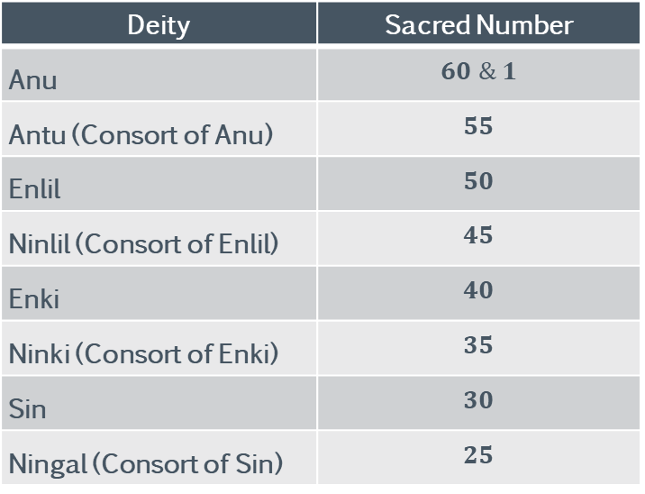
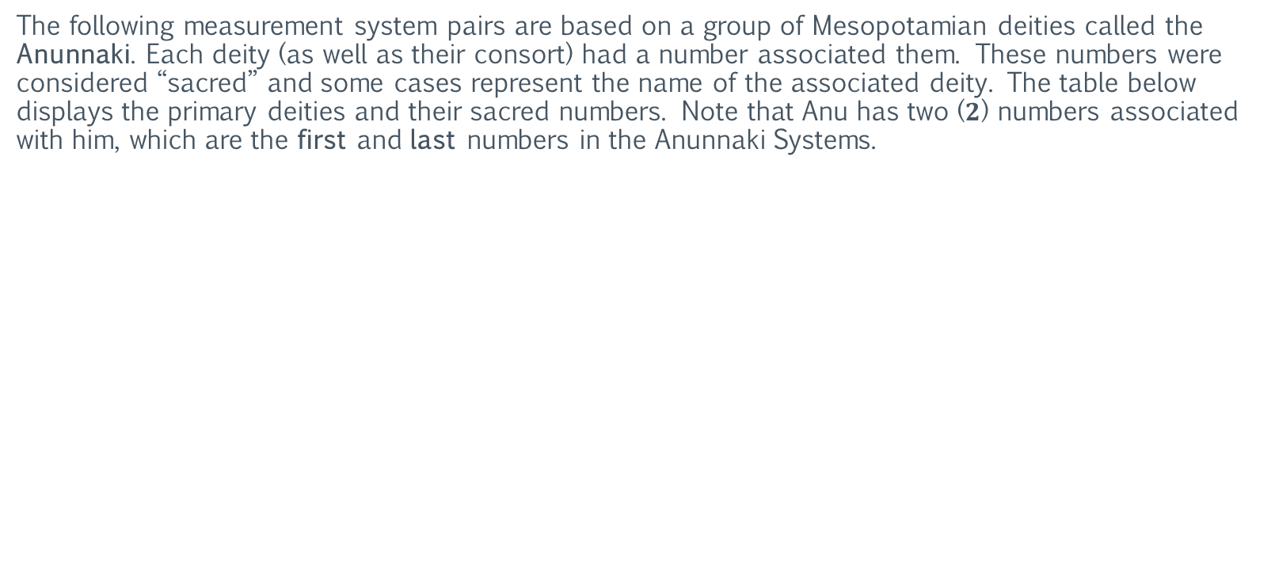
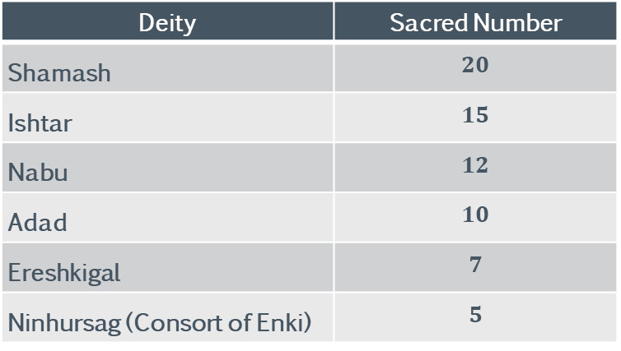
Measurement Systems
The Anunnaki Systems
The following measurement system pairs are based on a group of Mesopotamian deities called the Anunnaki. Each deity (as well as their consort) had a number associated them. These numbers were considered “sacred” and some cases represent the name of the associated deity. The table below displays the primary deities and their sacred numbers. Note that Anu has two ($2$) numbers associated with him, which are the first and last numbers in the Anunnaki Systems.
Deity | Sacred Number
Anu | $$60 \& 1$$
Antu (Consort of Anu) | $$55$$
Enlil | $$50$$
Ninlil (Consort of Enlil) | $$45$$
Enki | $$40$$
Ninki (Consort of Enki) | $$35$$
Sin | $$30$$
Ningal (Consort of Sin) | $$25$$
Deity | Sacred Number
Shamash | $$20$$
Ishtar | $$15$$
Nabu | $$12$$
Adad | $$10$$
Ereshkigal | $$7$$
Ninhursag (Consort of Enki) | $$5$$
https://en.wikipedia.org/wiki/Anunnaki

Slide 34
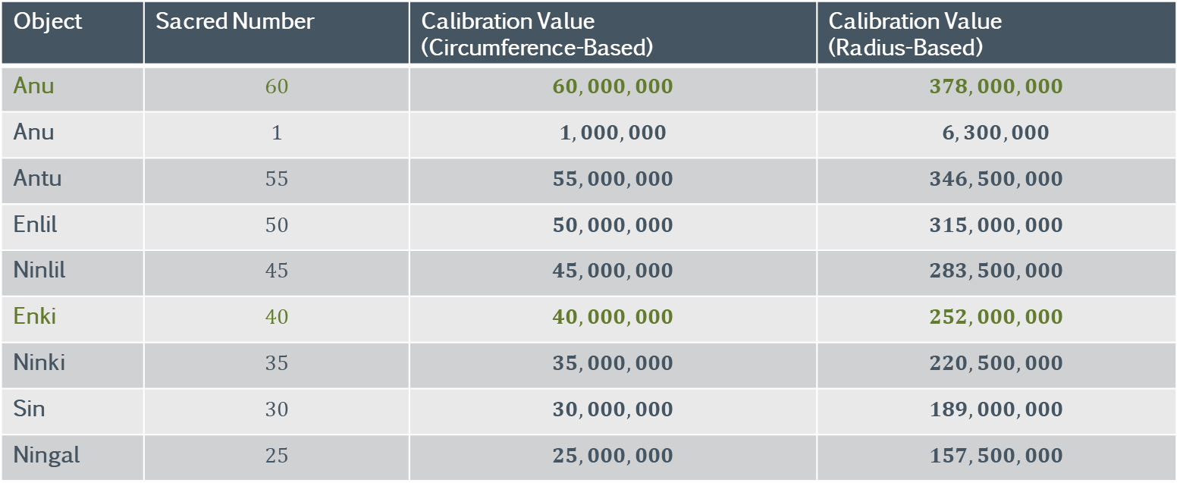
Measurement Systems
The Anunnaki Systems
The table below displays the calibration values for the Anunnaki Systems. The calibration value is derived from the “sacred” number of the deity.
Object | Sacred Number | Calibration Value (Circumference-Based) | Calibration Value (Radius-Based)
Anu | $$60$$ | $$60,000,000$$ | $$378,000,000$$
Anu | $$1$$ | $$1,000,000$$ | $$6,300,000$$
Antu | $$55$$ | $$55,000,000$$ | $$346,500,000$$
Enlil | $$50$$ | $$50,000,000$$ | $$315,000,000$$
Ninlil | $$45$$ | $$45,000,000$$ | $$283,500,000$$
Enki | $$40$$ | $$40,000,000$$ | $$252,000,000$$
Ninki | $$35$$ | $$35,000,000$$ | $$220,500,000$$
Sin | $$30$$ | $$30,000,000$$ | $$189,000,000$$
Ningal | $$25$$ | $$25,000,000$$ | $$157,500,000$$
https://en.wikipedia.org/wiki/Anunnaki

Slide 35

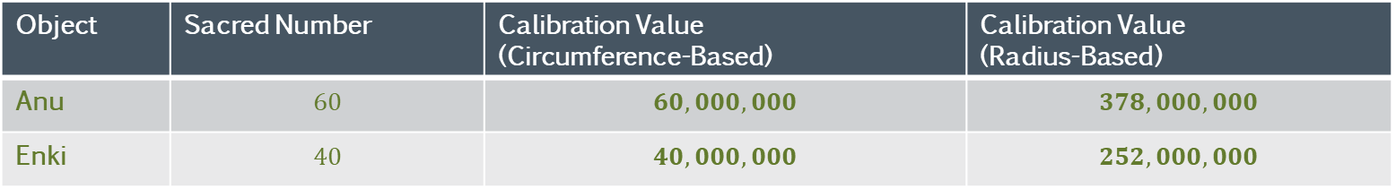
Measurement Systems
The Anunnaki Systems
The table below displays the calibration values for the Anu and Enki Anunnaki Systems. The calibration value is derived from the “sacred” number of the deity.
Object | Sacred Number | Calibration Value (Circumference-Based) | Calibration Value (Radius-Based)
Anu | $$60$$ | $$60,000,000$$ | $$378,000,000$$
Enki | $$40$$ | $$40,000,000$$ | $$252,000,000$$
Note that the circumference-based Anu system represents the gravity ant ($60,000,000$). Also note that the circumference-based calibration value for Enki is very close to the size of the meter.
https://en.wikipedia.org/wiki/Anunnaki

Slide 36
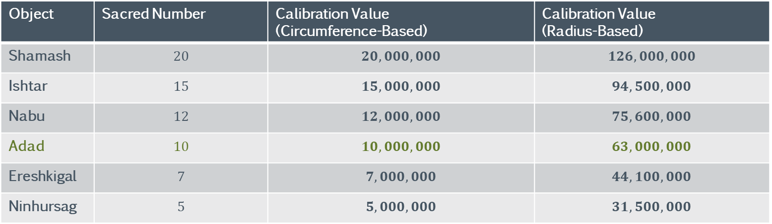

Measurement Systems
The Anunnaki Systems
The table below displays the calibration values for the Anunnaki Systems. The calibration value is derived from the “sacred” number of the deity.
Object | Sacred Number | Calibration Value (Circumference-Based) | Calibration Value (Radius-Based)
Shamash | $$20$$ | $$20,000,000$$ | $$126,000,000$$
Ishtar | $$15$$ | $$15,000,000$$ | $$94,500,000$$
Nabu | $$12$$ | $$12,000,000$$ | $$75,600,000$$
Adad | $$10$$ | $$10,000,000$$ | $$63,000,000$$
Ereshkigal | $$7$$ | $$7,000,000$$ | $$44,100,000$$
Ninhursag | $$5$$ | $$5,000,000$$ | $$31,500,000$$
Note that the radius-based Adad system represents the sacred cubit ($63,000,000$).
https://en.wikipedia.org/wiki/Anunnaki

Slide 37
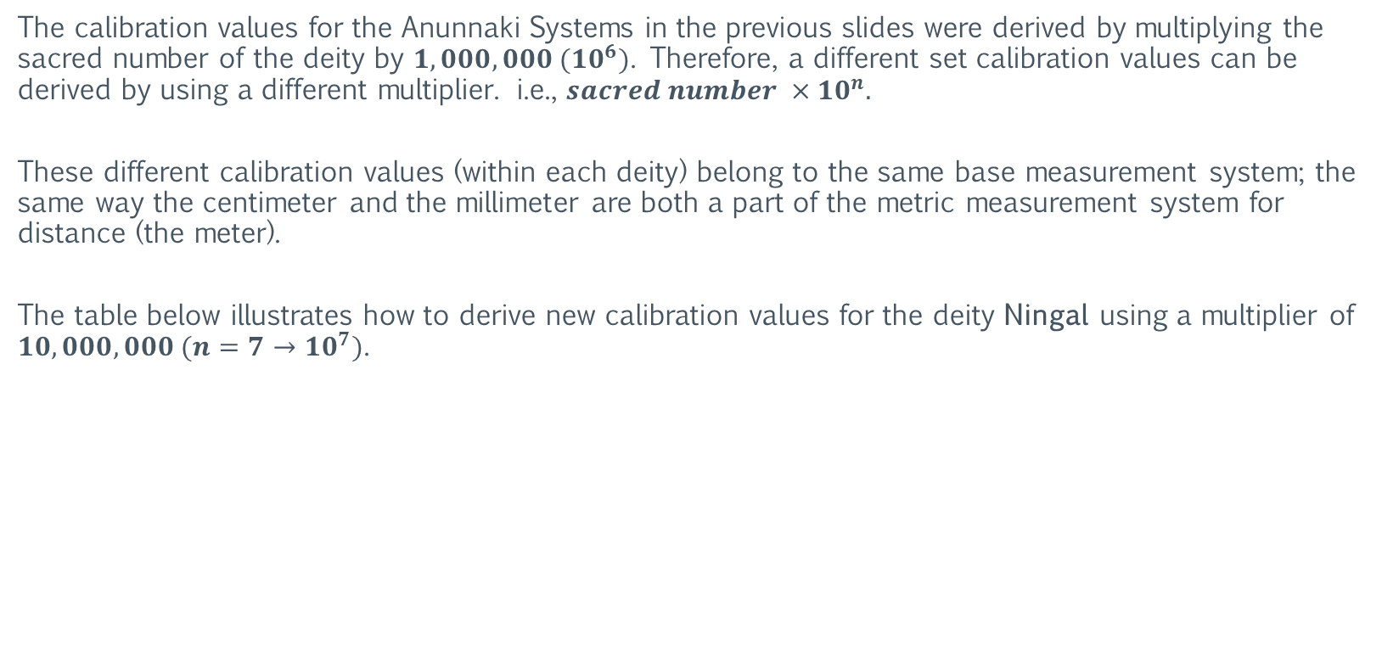
Measurement Systems
The Anunnaki Systems
The calibration values for the Anunnaki Systems in the previous slides were derived by multiplying the sacred number of the deity by $1,000,000 ({10}^{6})$. Therefore, a different set calibration values can be derived by using a different multiplier. i.e., ${sacred number ×10}^{n}.$
These different calibration values (within each deity) belong to the same base measurement system; the same way the centimeter and the millimeter are both a part of the metric measurement system for distance (the meter).
The table below illustrates how to derive new calibration values for the deity Ningal using a multiplier of $10,000,000 ({n=7→10}^{7})$.
Object | Sacred Number | Calibration Value (Circumference-Based) | Calibration Value (Radius-Based)
Ningal | $$25×10,000,000$$ | $$250,000,000$$ | $$1,575,000,000$$
Note that the radius-based Ningal system represents the pyramid inch ($1,575,000,000$).
https://en.wikipedia.org/wiki/Anunnaki

Slide 38
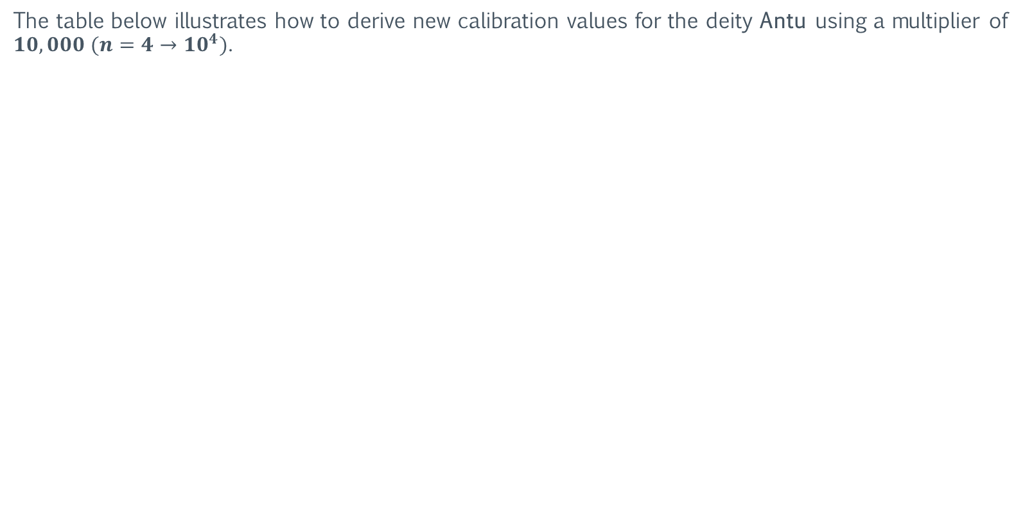
Measurement Systems
The Anunnaki Systems
The table below illustrates how to derive new calibration values for the deity Antu using a multiplier of $10,000 ({n=4→10}^{4})$.
Object | Sacred Number | Calibration Value (Circumference-Based) | Calibration Value (Radius-Based)
Antu | $$55×10,000$$ | $$550,000$$ | $$3,465,000$$
Note that the circumference-based Antu system represents the sexagesimal system for the Sun ($550,000$).
https://en.wikipedia.org/wiki/Anunnaki

Slide 39
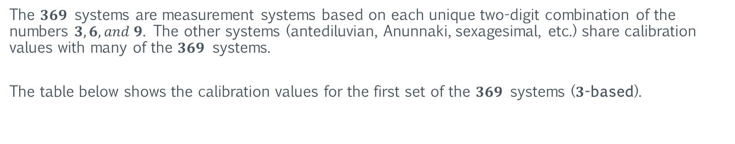
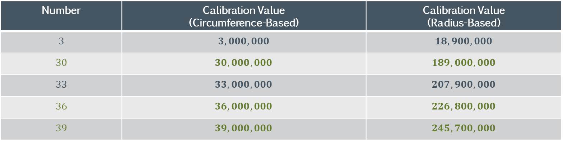
Measurement Systems
The $369$ Systems
The $369$ systems are measurement systems based on each unique two-digit combination of the numbers $3, 6, and 9$. The other systems (antediluvian, Anunnaki, sexagesimal, etc.) share calibration values with many of the $369$ systems.
The table below shows the calibration values for the first set of the $369$ systems ($3$-based).
Number | Calibration Value (Circumference-Based) | Calibration Value (Radius-Based)
$$3$$ | $$3,000,000$$ | $$18,900,000$$
$$30$$ | $$30,000,000$$ | $$189,000,000$$
$$33$$ | $$33,000,000$$ | $$207,900,000$$
$$36$$ | $$36,000,000$$ | $$226,800,000$$
$$39$$ | $$39,000,000$$ | $$245,700,000$$

Slide 40
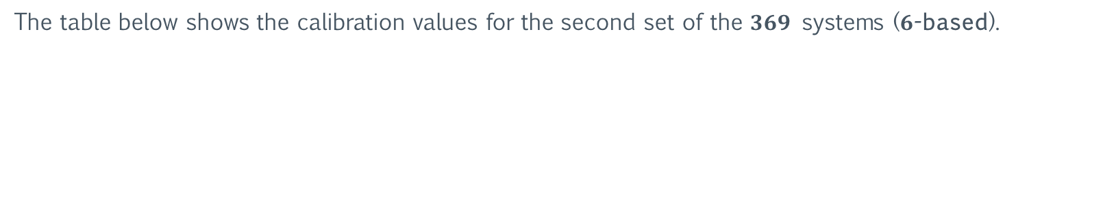
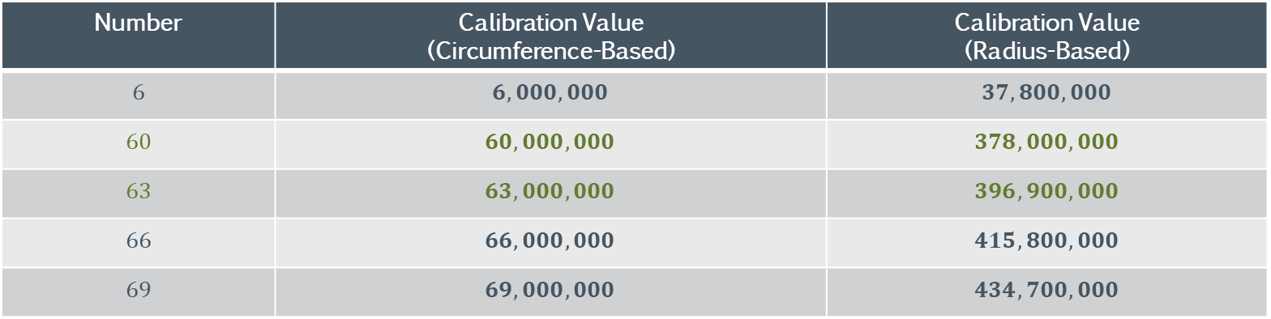
Measurement Systems
The $369$ Systems
The table below shows the calibration values for the second set of the $369$ systems ($6$-based).
Number | Calibration Value (Circumference-Based) | Calibration Value (Radius-Based)
$$6$$ | $$6,000,000$$ | $$37,800,000$$
$$60$$ | $$60,000,000$$ | $$378,000,000$$
$$63$$ | $$63,000,000$$ | $$396,900,000$$
$$66$$ | $$66,000,000$$ | $$415,800,000$$
$$69$$ | $$69,000,000$$ | $$434,700,000$$

Slide 41
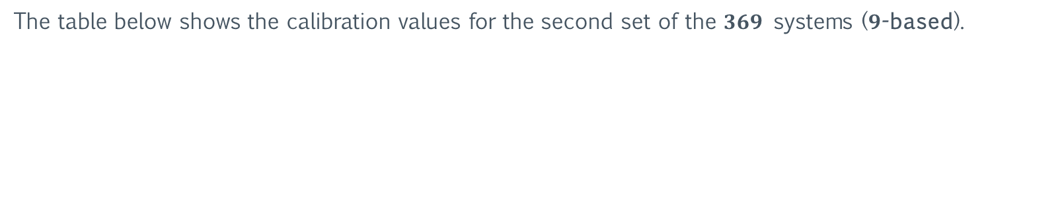
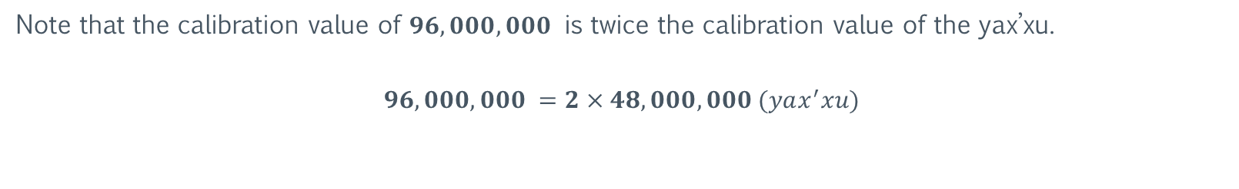
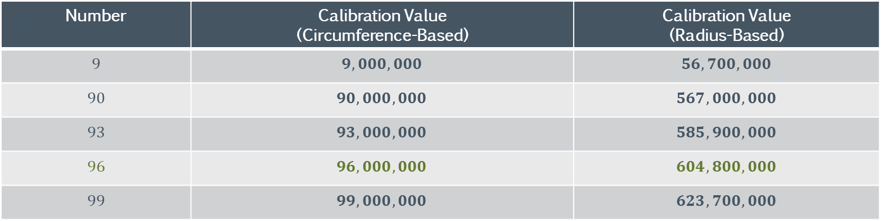
Measurement Systems
The $369$ Systems
The table below shows the calibration values for the second set of the $369$ systems ($9$-based).
Number | Calibration Value (Circumference-Based) | Calibration Value (Radius-Based)
$$9$$ | $$9,000,000$$ | $$56,700,000$$
$$90$$ | $$90,000,000$$ | $$567,000,000$$
$$93$$ | $$93,000,000$$ | $$585,900,000$$
$$96$$ | $$96,000,000$$ | $$604,800,000$$
$$99$$ | $$99,000,000$$ | $$623,700,000$$
Note that the calibration value of $96,000,000$ is twice the calibration value of the yax’xu.
$$96,000,000 =2×48,000,000 (yax^{′}xu)$$

Slide 42
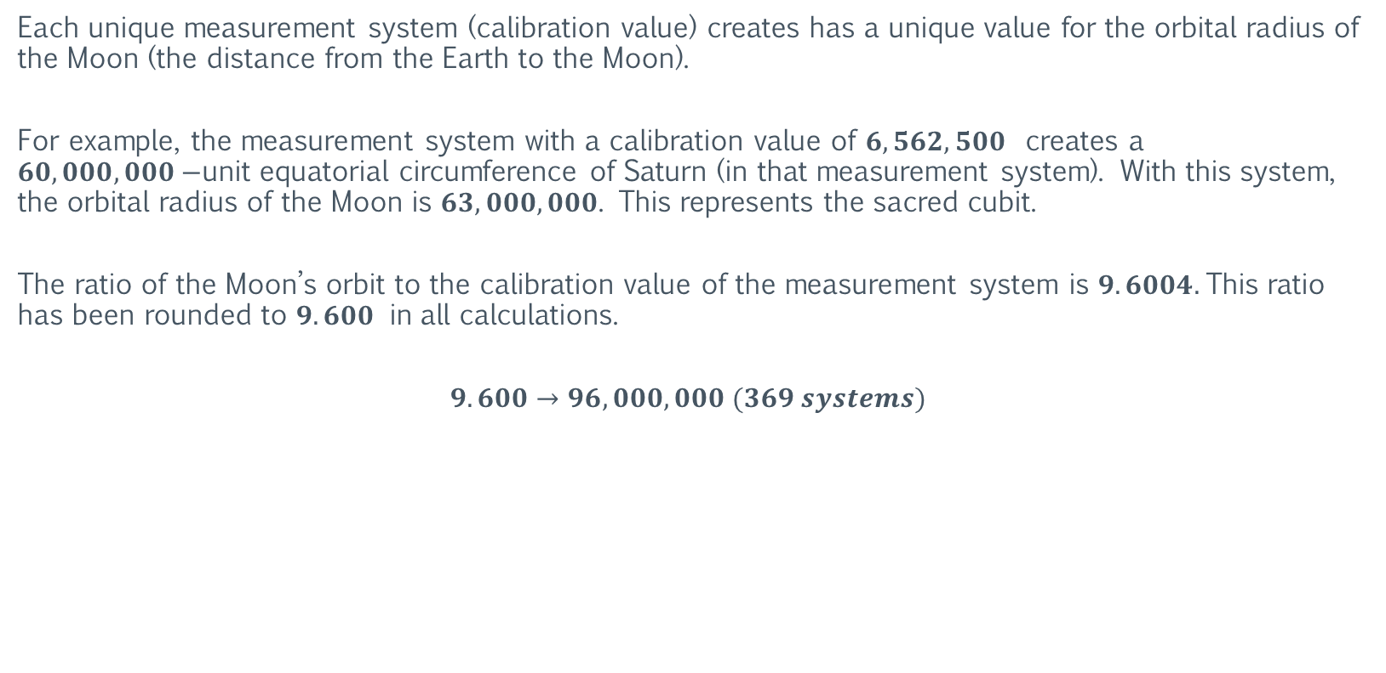
Measurement Systems
The Moon’s Orbit
Each unique measurement system (calibration value) creates has a unique value for the orbital radius of the Moon (the distance from the Earth to the Moon).
For example, the measurement system with a calibration value of $6,562,500$ creates a $60,000,000−$unit equatorial circumference of Saturn (in that measurement system). With this system, the orbital radius of the Moon is $63,000,000$. This represents the sacred cubit.
The ratio of the Moon’s orbit to the calibration value of the measurement system is $9.6004.$This ratio has been rounded to $9.600$ in all calculations.
$$9.600→96,000,000 (369 systems)$$

Slide 43
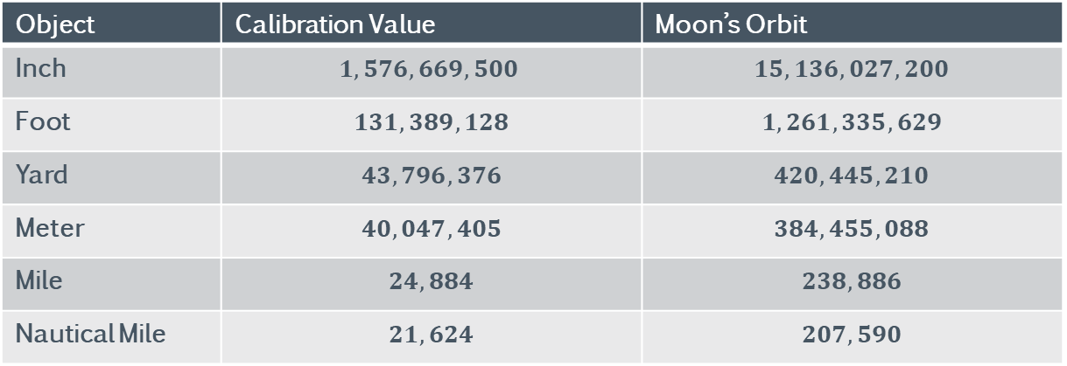
Measurement Systems
The Moon’s Orbit: The Standard Systems
The table below displays the value for the Moon’s orbit for the antediluvian measurement systems.
Object | Calibration Value | Moon’s Orbit
Inch | $$1,576,669,500$$ | $$15,136,027,200$$
Foot | $$131,389,128$$ | $$1,261,335,629$$
Yard | $$43,796,376$$ | $$420,445,210$$
Meter | $$40,047,405$$ | $$384,455,088$$
Mile | $$24,884$$ | $$238,886$$
Nautical Mile | $$21,624$$ | $$207,590$$

Slide 44
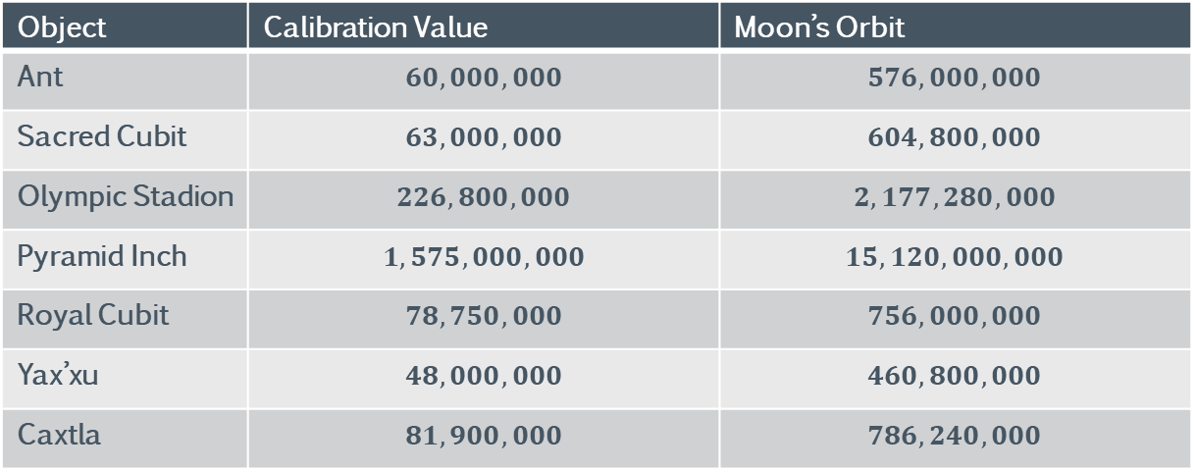
Measurement Systems
The Moon’s Orbit: The Antediluvian Systems
The table below displays the value for the Moon’s orbit for the antediluvian measurement systems.
Object | Calibration Value | Moon’s Orbit
Ant | $$60,000,000$$ | $$576,000,000$$
Sacred Cubit | $$63,000,000$$ | $$604,800,000$$
Olympic Stadion | $$226,800,000$$ | $$2,177,280,000$$
Pyramid Inch | $$1,575,000,000$$ | $$15,120,000,000$$
Royal Cubit | $$78,750,000$$ | $$756,000,000$$
Yax’xu | $$48,000,000$$ | $$460,800,000$$
Caxtla | $$81,900,000$$ | $$786,240,000$$

Slide 45
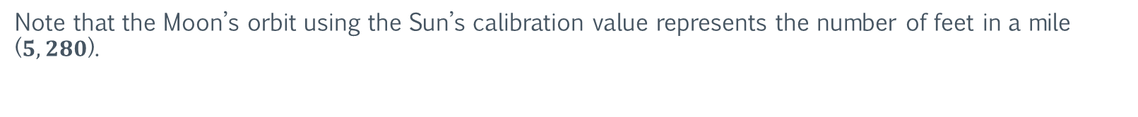
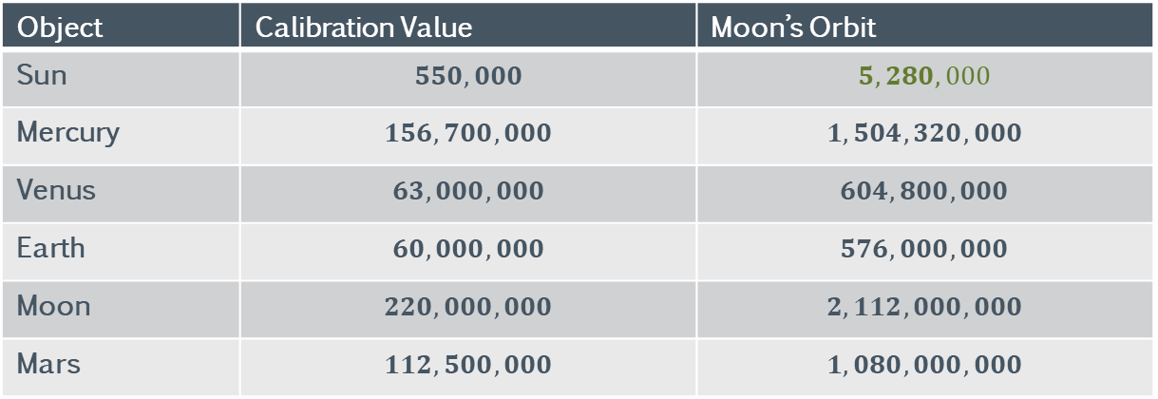
Measurement Systems
The Moon’s Orbit: The Solar Sexagesimal Systems (Circumference-Based)
The table below displays the value for the Moon’s orbit for the sexagesimal calibration values (circumference-based) of the inner objects of the solar system.
Object | Calibration Value | Moon’s Orbit
Sun | $$550,000$$ | $$5,280,000$$
Mercury | $$156,700,000$$ | $$1,504,320,000$$
Venus | $$63,000,000$$ | $$604,800,000$$
Earth | $$60,000,000$$ | $$576,000,000$$
Moon | $$220,000,000$$ | $$2,112,000,000$$
Mars | $$112,500,000$$ | $$1,080,000,000$$
Note that the Moon’s orbit using the Sun’s calibration value represents the number of feet in a mile ($5,280$).

Slide 46

Measurement Systems
The Moon’s Orbit: The Solar Sexagesimal Systems (Radius-Based)
The table below displays the value for the Moon’s orbit for the sexagesimal calibration values (radius-based) of the inner objects of the solar system.
Object | Calibration Value | Moon’s Orbit
Sun | $$3,465,000$$ | $$33,264,000$$
Mercury | $$987,210,000$$ | $$1,504,320,000$$
Venus | $$396,900,000$$ | $$9,477,216,000$$
Earth | $$378,000,000$$ | $$3,628,800,000$$
Moon | $$1,386,000,000$$ | $$13,305,600,000$$
Mars | $$708,750,000$$ | $$6,804,000,000$$

Slide 47


Measurement Systems
The Moon’s Orbit: The Solar Sexagesimal Systems (Circumference-Based)
The table below displays the value for the Moon’s orbit for the sexagesimal calibration values (circumference-based) of the outer objects of the solar system.
Object | Calibration Value | Moon’s Orbit
Jupiter | $$5,468,750$$ | $$52,500,000$$
Saturn | $$6,562,500$$ | $$63,000,000$$
Uranus | $$15,000,000$$ | $$144,000,000$$
Neptune | $$15,625,000$$ | $$150,000,000$$
Pluto | $$321,200,000$$ | $$3,083,520,000$$
Note that the Moon’s orbit using Saturn’s calibration value represents the sacred cubit ($63,000,000$).

Slide 48

Measurement Systems
The Moon’s Orbit: The Solar Sexagesimal Systems (Radius-Based)
The table below displays the value for the Moon’s orbit for the sexagesimal calibration values (radius-based) of the outer objects of the solar system.
Object | Calibration Value | Moon’s Orbit
Jupiter | $$34,453,125$$ | $$330,750,000$$
Saturn | $$41,343,750$$ | $$396,900,000$$
Uranus | $$94,500,000$$ | $$907,200,000$$
Neptune | $$98,437,500$$ | $$945,000,000$$
Pluto | $$2,023,560,000$$ | $$19,426,176,000$$

Slide 49



Measurement Systems
The Moon’s Orbit: The Anunnaki Systems (Circumference-Based)
The table below displays the value for the Moon’s orbit for the sexagesimal calibration values (circumference-based) of the first $8$ Anunnaki Systems.
Object | Calibration Value | Moon’s Orbit
Anu (60) | $$60,000,000$$ | $$576,000,000$$
Anu (1) | $$1,000,000$$ | $$9,600,000$$
Antu | $$55,000,000$$ | $$528,000,000$$
Enlil | $$50,000,000$$ | $$480,000,000$$
Ninlil | $$45,000,000$$ | $$432,000,000$$
Enki | $$40,000,000$$ | $$384,000,000$$
Ninki | $$35,000,000$$ | $$336,000,000$$
Sin | $$30,000,000$$ | $$288,000,000$$
Ningal | $$25,000,000$$ | $$240,000,000$$
Note that the Moon’s orbit using Ningal’s calibration value equals the equatorial circumference of Uranus ($240,000,000$).

Slide 50


Measurement Systems
The Moon’s Orbit: The Anunnaki Systems (Circumference-Based)
The table below displays the value for the Moon’s orbit for the sexagesimal calibration values (circumference-based) of the remaining Anunnaki Systems.
Object | Calibration Value | Moon’s Orbit
Shamash | $$20,000,000$$ | $$192,000,000$$
Ishtar | $$15,000,000$$ | $$144,000,000$$
Nabu | $$12,000,000$$ | $$115,200,000$$
Adad | $$10,000,000$$ | $$96,000,000$$
Ereshkigal | $$7,000,000$$ | $$67,200,000$$
Ninhursag | $$5,000,000$$ | $$48,000,000$$
Note that the Moon’s orbit using Ninhursag’s calibration value represents the Yax’xu ($48,000,000$).

Slide 51


Measurement Systems
The Moon’s Orbit: The Anunnaki Systems (Radius-Based)
The table below displays the value for the Moon’s orbit for the sexagesimal calibration values (radius-based) of the first $8$ Anunnaki Systems.
Object | Calibration Value | Moon’s Orbit
Anu (60) | $$378,000,000$$ | $$3,628,800,000$$
Anu (1) | $$6,300,000$$ | $$60,480,000$$
Antu | $$346,500,000$$ | $$3,326,400,000$$
Enlil | $$315,000,000$$ | $$3,024,000,000$$
Ninlil | $$283,500,000$$ | $$2,721,600,000$$
Enki | $$252,000,000$$ | $$2,419,200,000$$
Ninki | $$220,500,000$$ | $$2,116,800,000$$
Sin | $$189,000,000$$ | $$1,814,400,000$$
Ningal | $$157,500,000$$ | $$1,512,000,000$$
Note that the Moon’s orbit using Ningal’s calibration value equals the equatorial circumference of Uranus ($240,000,000$).

Slide 52

Measurement Systems
The Moon’s Orbit: The Anunnaki Systems (Radius-Based)
The table below displays the value for the Moon’s orbit for the sexagesimal calibration values (radius-based) of the remaining Anunnaki Systems.
Object | Calibration Value | Moon’s Orbit
Shamash | $$126,000,000$$ | $$1,209,600,000$$
Ishtar | $$94,500,000$$ | $$907,200,000$$
Nabu | $$75,600,000$$ | $$725,760,000$$
Adad | $$63,000,000$$ | $$604,800,000$$
Ereshkigal | $$44,100,000$$ | $$423,360,000$$
Ninhursag | $$31,500,000$$ | $$302,400,000$$

Slide 53

Section III: The Antediluvian Year
The following section examines the antediluvian year, which consisted of $360$ days, as well as ancient calendars that reflect this orbital period (length of year).

Slide 54


The Antediluvian Year
Plato’s War Chariot
Recall from $Part I$ that the components of Plato’s War Chariot are used to derive the average orbital radius of the Earth.
War Chariot Derived Number | $$222,011,222,334$$
An average orbit of $222,000,000,000 a$ would create an orbital period (year) of exactly $360$ days. The “remaining” $11,222,334 a$ is equivalent to $11.1$ seconds/year.
These numbers are placeholders for “$0$’s”, thus allowing the full number ($222$ billion) to be built without the last $9$ components of the War Chariot being described as containing nothing (zero). However, the numerical value(s) of these placeholders are not random. This will be examined in the next section.

Slide 55



The Antediluvian Year
Plato’s War Chariot
The table below shows the antediluvian orbital information for Earth. An average orbit of $222,000,000,000 a$ would create an orbital period (year) of exactly $360$ days.
$$\text{Earth} \text{Orbit}$$ | $$\text{Ants}$$ | $$\text{P}\text{−}\text{Ratio}$$
$$\text{Minimum}$$ | $$217,200,000,000$$ | $$7.23 pr$$
$$\text{Average}$$ | $$222,000,000,000$$ | $$7.4 pr$$
$$\text{Max}$$ | $$226,800,000,000$$ | $$7.56 pr$$
These values use an orbital eccentricity of $.0216 (60×60×60=216,000=Sexagesimal)$.
Note that the maximum orbit is exactly $226,800,000,000 a$. This distance has a P-Ratio of $7.56$, which is $3.78×2$. Recall from $Part II$, that Plato’s “normalizing” multiplier is $3.78$.

Slide 56

The Antediluvian Year
The Sexagesimal Calendar
A $360$-day year would adhere to the sexagesimal number system.
A $360$-day year would allow for $12$ months of exactly $30$ days each. It would also synchronize the moon's $30$-day orbit/cycle directly with the $30$ days of each month.
A $360$-day year would mirror the division of the Earth in degrees ($360$). Whereas minutes and seconds are currently used in the DMS (Degrees, Minutes, Seconds) coordinate system, the "day" would be the functional equivalent of the degree.
https://en.wikipedia.org/wiki/Sexagesimal

Slide 57

The Antediluvian Year
Ancient 360-Day Calendars
Roman Calendar
Plutarch's Parallel Lives recounts that Romulus's calendar had been solar but adhered to the general principle that the year should last for $360$ days. Months were employed secondarily and haphazardly, with some counted as $20$ days and others as $35$ or more.
India
The Rig Veda describes a calendar with $12$ months and $360$ days.
Mesoamerica
In the Mayan Long Count Calendar, the equivalent of the year, the tun, was $360$ days. The “days" component of the Mayan calendar rotates (resets) at $360$. The calendar specifically violates (makes an exception to) its base $20$ numbering system to force the days component to roll over "early" at $360$.
https://en.wikipedia.org/wiki/360-day_calendar

Slide 58

The Antediluvian Year
Ancient 360-Day Calendars
The Ancient Egyptians
The ancient Egyptians originally used a $360$-day calendar. One myth tells of how the extra $5$ days were added:
"A long time ago, Ra, who was god of the sun, ruled the earth. During this time, he heard of a prophecy that Nut, the sky goddess, would give birth to a son who would depose him. Therefore, Re cast a spell to the effect that Nut could not give birth on any day of the year, which was then itself composed of precisely $360$ days. To help Nut to counter this spell, the wisdom god Thoth devised a plan. Thoth went to the moon god Khonsu and asked that he play a game known as Senet, requesting that they play for the very light of the moon itself. Feeling confident that he would win, Khonsu agreed….”
https://en.wikipedia.org/wiki/360-day_calendar#Egypt

Slide 59

The Antediluvian Year
Ancient 360-Day Calendars
The Ancient Egyptians
“However, while playing he lost the game several times in succession, such that Thoth ended up winning from the moon a substantial measure of its light, equal to about five days. With this in hand, Thoth then took this extra time, and gave it to Nut. In doing so this had the effect of increasing the earth’s number of days per year, allowing Nut to give birth to a succession of children; one upon each of the extra $5$ days that were added to the original $360$. And as for the moon, losing its light had quite an effect upon it, for it became weaker and smaller in the sky. Being forced to hide itself periodically to recuperate; it could only show itself fully for a short period of time before having to disappear to regain its strength."
https://en.wikipedia.org/wiki/360-day_calendar#Egypt

Slide 60

Section IV: The Light-Year
The following section examines the properties of the light-year adjusted for a year of $360$ days. The purpose is to illustrate the mathematical consequences (and “phenomenon”) that arise from this adjustment.

Slide 61


The Light-Year
Definition
A light-year (ly) is a large unit of length used to express astronomical distances and is equivalent to about $9.46$ trillion kilometers ($9.46×{10}^{12} km$), or $5.88$ trillion miles ($5.88×{10}^{12} mi$). As defined by the International Astronomical Union (IAU), a light-year is the distance that light travels in vacuum in one Julian year ($365.25$ days).
The light-year is most often used when expressing distances to stars and other distances on a galactic scale, especially in non-specialist contexts and popular science publications. The unit most used in professional astronomy is the parsec (symbol: pc, about $3.26$ light-years) which derives from astrometry; it is the distance at which one astronomical unit subtends an angle of one second of arc.
The Light-Year
$$\text{Unit}$$ | $$\text{Distance}$$
$$\text{Kiloant}\text{ (}\text{Gravity} \text{Ant}\text{)}$$ | $$1.42×{10}^{13}$$
$$\text{Kilometer}$$ | $$9.46×{10}^{12}$$
$$\text{Mile}$$ | $$5.88×{10}^{12}$$
https://en.wikipedia.org/wiki/Light-year

Slide 62


The Light-Year
The Speed of Light
The table below displays the values for the speed of light (represented by a lower case $"c"$).
Measurement System | Speed of Light Value ($c$)
Ant (Gravity) | $$c=449,156,885 a/s$$
Meter | $$c=299,792,458{ m}/s$$
The speed of light is constant for all reference frames (as measured in a vacuum). This means its value is constant regardless of the relative velocity of all observers to the source of the light.
https://en.wikipedia.org/wiki/Speed_of_light

Slide 63



The Light-Year
The Light Ant
Recall from $Part II$ how the light ant creates a non-fractional value for the speed of light. This makes the light ant an ideal system for measuring large distances (such as interstellar distances).
Measurement System | Calibration Value | Speed of Light Value ($c$)
Gravity Ant ($a$) | $$60,000,000$$ | $$c=449,156,885 a/s$$
Light Ant ($la$) | $$60,112,694$$ | $$c=450,000,000 {la}/s$$
Recall that the gravitational constant ($G_{ants}$) is $1.00×{10}^{−10}$.
$$Δ=100,000=1×{10}^{5}$$
$$G=1.00×{10}^{−10}=\frac{1}{Δ^{2}}$$

Slide 64


The Light-Year
$${The Speed of Light}^{2}$$
The square of the speed of light (which can be found in many physics' equations such as Einstein’s famous $E=mc^{2}$) is $202,500,000,000,000,000$ $(2.025×{10}^{17})$
$$c^{2}$$
$$2.025×{10}^{17} la$$ | $$202,500,000,000,000,000 la$$
https://en.wikipedia.org/wiki/Mass%E2%80%93energy_equivalence

Slide 65



The Light-Year
The Antediluvian Light-Year
The antediluvian light-year (aly) is the light-year adjusted to a $360$-day year. The table below shows the distance values of the antediluvian light-year for both the light ant and the gravity ant.
The Antediluvian Light-Year
Unit | Distance | Distance | P-Ratio
$$\text{Light} \text{Ant}\text{ (}\text{la}\text{)}$$ | $$13,996,800,000,000,000 la$$ | $$1.39968×{10}^{16} la$$ | $$465,700 pr$$
$$\text{Gravity} \text{Ant}\text{ (}\text{a}\text{)}$$ | $$13,970,575,751,040,000 a$$ | $$1.39706×{10}^{16} a$$ | $$465,700 pr$$
Note that the longitude coordinate for Atlantis is $−11.397°$.

Slide 66


The Light-Year
The Antediluvian Light-Year
Note that the inverse of the light-year P-Ratio has the same decimal value as the average orbital radius of Saturn.
The Antediluvian Light-Year
Light-Year P-Ratio | Inverse of Light-Year P-Ratio
$$465,685.16 pr$$ | $$2.147×{10}^{−6}$$
Average Orbital Radius of Saturn
$$2.147×{10}^{12} a$$ | $$\sim 2,147, 000,000,000 a$$

Slide 67

The Light-Year
The Antediluvian Light-Year
Note that the antediluvian light-year (aly) value for the light ant is very close to $14,000,000,000,000,000 (1.400×{10}^{16})$, with a difference/offset of $3.2×{10}^{12}$.
The Antediluvian Light-Year Offset
$$14,000,000,000,000,000−13,996,800,000,000,000=3,200,000,000,000$$

Slide 68




The Light-Year
The Antediluvian Light-Year Offset: Mars
This “offset” is the same decimal value for the equatorial circumference of Mars and has a P-Ratio of $106.47$.
The Antediluvian Light-Year Offset |  | P-Ratio
$$3,200,000,000,000 la$$ | $$3.20×{10}^{12} la$$ | $$106.14 pr$$
Mars Equatorial Circumference
$$\sim 32,000,000 la$$ | $$\sim 3.20×{10}^{7} la$$
The difference in the quantitative value ($Δ$) is a factor of ${1×10}^{5}$.
$$∵Δ={1×10}^{5}∴G=1/{Δ^{2}}$$

Slide 69



The Light-Year
The Antediluvian Light-Year Offset Ratio
The tables below show the $2$ antediluvian light-year offset ratios and their inverse.
Antediluvian Light-Year Offset Ratio | Antediluvian Light-Year Offset Ratio
$$\frac{3,200,000,000,000}{13,996,800,000,000,000}$$ | $$.0022862368541380887059899405578418$$
$$\frac{3,200,000,000,000}{14,000,000,000,000,000}$$ | $$.0022857142857142857142857142857143$$
Antediluvian Light-Year Offset Ratio
Inverse Ratio | Inverse Ratio $÷12$
$$4,374$$ | $$4,374÷12=364.5 (days)$$
$$4,375$$ | $$4,375÷12=364.58$$
https://en.wikipedia.org/wiki/Book_of_Enoch

Slide 70


The Light-Year
The Antediluvian Light-Year Offset Ratio
Note that using the inverse ratio value of $4,375 (×1,000)$ as a calibration value will create the following equatorial circumferences:
$$Calibration Value = 4,375$$
Planet | Equatorial Circumference
Mercury | $$1,675,175$$
Venus | $$4,166,667$$
Earth | $$4,375,000$$
Mars | $$2,333,334$$
Jupiter | $$48,000,000$$
Saturn | $$40,000,000$$
Uranus | $$17,500,000$$
Neptune | $$16,800,000$$

Slide 71



The Light-Year
The Antediluvian Light-Year Offset Ratio: Earth
Both antediluvian light-year offset ratios have the same decimal value as the current maximum orbital radius of Earth.
The Antediluvian Light-Year Offset Ratio
$$2.286×{10}^{−4}$$
Current Maximum Orbital Radius of Earth
$$2.286×{10}^{11} la$$ | $$\sim 228,600,000,000 la$$
Antediluvian Maximum Orbital Radius of Earth
$$2.268×{10}^{11} a$$ | $$\sim 226,800,000,000 a$$

Slide 72


The Light-Year
The Oort Cloud
The Oort cloud, sometimes called the Öpik–Oort cloud, first described in 1950 by the Dutch astronomer Jan Oort, is a theoretical concept of a cloud of predominantly icy planetesimals proposed to surround the Sun at distances (radius) ranging from $1,000 − 100,000 AU$, ($0.015 − 1.6 light−years$).
https://en.wikipedia.org/wiki/Oort_cloud

Slide 73


The Light-Year
The Oort Cloud
The Oort cloud is divided into two regions: a disc-shaped inner Oort cloud (or Hills cloud) and a spherical outer Oort cloud. Both regions lie beyond the heliosphere and in interstellar space. The outer limit of the Oort cloud defines the cosmographic boundary of the Solar System and the extent of the Sun's Hill sphere.
Note that the outer boundary of the Oort cloud is located at $100,000 AU.$
$$100,000 AU=Earth Avg Orbit ×100,000=2.220×{10}^{11} ×100,000$$
$$2.220×{10}^{11} ×100,000=2.220×{10}^{16} a=740,000 P−Ratio$$
$$370,000×2=740,000$$
$$∵Δ=100,000∴G=1/{Δ^{2}}$$
https://en.wikipedia.org/wiki/Oort_cloud

Slide 74

The Light-Year
The Oort Cloud & Plato’s War Chariot
Recall the “remaining” $11,222,334 a$ from Plato’s War Chariot. This number, when multiplied by the distance to the outer boundary of the Oort Cloud ($100,000$), is equal the minimum orbital radius of Jupiter.
$$11,222,334×100,000=1.1222334×{10}^{12}=Min Orbit of Jupiter$$
$${P−Ratio}_{Jupiter}^{Min}=37.41$$
The entire War Chariot ($222,011,222,334$) represents the average orbital radius of Earth ($1 AU$).
$222,011,222,334×100,000=2.22011222334×{10}^{16}=Oort Cloud Boudary$
This is an indicator that Plato knew the distance to the boundary of the solar system (Oort Cloud) and was “embedding” this information within his dialogue(s).
$$∵Δ=100,000∴G=1/{Δ^{2}}$$

Slide 75


The Light-Year
The Antediluvian Parsec
The table below shows how the value for the antediluvian parsec is calculated for the gravity ant.
$$aly = antediluvian light−year$$
Gravity Ant Antediluvian Parsec (ga-apc) Calculation
$$π×ga−apc=180×60×60×\left(1 au\right)$$
$$π×ga−apc=\left(6.48×{10}^{5}\right)×\left(2.220×{10}^{11} a\right)=1.43856×{10}^{17}$$
$$ga−apc=\frac{1.43856×{10}^{17}}{π} a$$
$$ga−apc=4.57907869×{10}^{16} a$$
$$1 ga−apc=3.27766 aly$$
https://en.wikipedia.org/wiki/Parsec

Slide 76


The Light-Year
The Antediluvian Parsec
The table below shows how the value for the antediluvian parsec is calculated for the light ant.
$$aly = antediluvian light−year$$
Light Ant Antediluvian Parsec (la-apc) Calculation
$$π×la−apc=180×60×60×\left(1 au\right)$$
$$π×la−apc=\left(6.48×{10}^{5}\right)×\left(2.22417×{10}^{11} la\right)=1.441262×{10}^{17}$$
$$la−apc=\frac{1.43856×{10}^{17}}{π} la$$
$$la−apc=4.58768096×{10}^{16} la$$
$$1 la−apc=3.27766 aly$$
https://en.wikipedia.org/wiki/Parsec

Slide 77

Section V: The Model Solar System
The following section examines the properties of the solar system and how they represent various physical constants, mathematics, and aspects of the Standard Model of physics. The purpose is to underline the many “conspicuous” properties of the solar system, which is assumed to have formed $100\%$ “naturally”.

Slide 78




The Model Solar System
Earth: The Speed of Light
The average orbital radius of Earth has the same decimal value ($4.50×{10}^{12} la$) as the inverse of the speed of light.
Inverse of Speed of Light ($1/c$)
$$1/c=2.22×{10}^{−9} la/s$$
Earth Avg Orbital Radius
$$2.22×{10}^{11} la$$ | $$\sim 222,000,000,000 la$$
Therefore, the average orbit of Earth is a virtual representation of the inverse of speed of light ($1/c$).
https://en.wikipedia.org/wiki/Standard_Model

Slide 79


The Model Solar System
Mars: The Mass of the Top Quark
The mass of the Mars is equal to both the decimal and quantitative value for the inverse of the mass of the top quark fermion particle. Values are shown in kilotenna (kt).
Mass of Top Quark
$$6.9250×{10}^{−25} kt$$ | $$inverse=1.4437×{10}^{24} kt$$
Mass of Mars
$$1.4404×{10}^{24} kt$$ | $$inverse=6.9426×{10}^{−25} kt$$
Therefore, the mass of Mars is a virtual representation of the inverse of the mass of the top quark fermion particle.
https://en.wikipedia.org/wiki/Top_quark

Slide 80




The Model Solar System
The Lifetime of the Top Quark
Recall that the mass of the Higgs boson is $5.00×{10}^{−25} kt$.
Mass of Higgs Boson
$$5.00×{10}^{−25} kt$$
Because of its enormous mass, the top quark is extremely short-lived, with a predicted lifetime of only $5.00×{10}^{−25} seconds$. As a result, top quarks do not have time before they decay to form hadrons as other quarks do.
Lifetime of Top Quark
$$5.00×{10}^{−25} s$$
https://en.wikipedia.org/wiki/Top_quark

Slide 81


The Model Solar System
Mars: The Mass of the W Boson
The minimum orbital radius of Mars is equal to the decimal value for the inverse of the mass of the W boson particle. Values are shown in kilotenna (kt) and ants (a).
Mass of W Boson
$$3.21667×{10}^{−25} kt$$ | $$inverse=3.10×{10}^{24} kt$$
Mars Min Orbital Radius
$$3.10×{10}^{11} a$$ | $$\sim 310,000,000,000 a$$
Therefore, the minimum orbital radius of Mars is a virtual representation of the inverse of the mass of the W boson particle.
https://en.wikipedia.org/wiki/W_and_Z_bosons

Slide 82



The Model Solar System
Mars: The Ratio of the Mass of the Sun
The ratio of the mass of the Sun to the mass of Mars is equal to the decimal value of the minimum orbital radius of Mars. Values are shown in ants (a) and kilotenna (kt).
Mass Ratio
$$Sun$$ | $$4.4635×{10}^{30} kt$$
$$Mars$$ | $$1.4404×{10}^{24} kt$$
$${Ratio}_{Mars}^{Sun}$$ | $$3.10×{10}^{6}$$
The difference in the quantitative value ($Δ$) is a factor of ${1×10}^{5}$.
$$∵Δ={1×10}^{5}∴G=1/{Δ^{2}}$$
Mars Min Orbital Radius
$$3.10×{10}^{11} a$$ | $$\sim 310,000,000,000 a$$
Therefore, the minimum orbital radius of Mars is a virtual representation of the ratio of the mass of the Sun to the mass of Mars.

Slide 83





The Model Solar System
Saturn: The Speed of Light Squared
The minimum orbital radius of Saturn has the same decimal value ($2.025×{10}^{12} la$) as the speed of light squared ($c^{2}$).
$${Speed of Light}^{2}$$
$$c^{2}=2.025×{10}^{17} la/s$$ | $$c^{2}=202,500,000,000,000,000 la/s$$
The difference in the quantitative value ($Δ$) is a factor of ${1×10}^{5}$.
$$∵Δ={1×10}^{5}∴G=1/{Δ^{2}}$$
Saturn Min Orbital Radius
$$2.025×{10}^{12} la$$ | $$\sim 2,025,000,000,000 la$$
Therefore, the minimum orbit of Saturn is a virtual representation of the speed of light squared ($c^{2}$).

Slide 84




The Model Solar System
Saturn: The 8th Mersenne Prime Number
The average orbital radius of Saturn has same decimal value ($2.147×{10}^{12} la$) as the $8th$ Mersenne prime number.
$$\text{8}\text{th} \text{Mersenne} \text{Prime} \text{Number}$$
$$2^{31}−1=2,147,483,647$$
Saturn Average Orbital Radius
$$2.147×{10}^{12} a$$ | $$\sim 2,147,483,647,000 a$$
Therefore, the average orbit of Saturn is a virtual representation of the $8th$ Mersenne prime number.
https://en.wikipedia.org/wiki/2,147,483,647

Slide 85




The Model Solar System
Saturn: The Planck Length
The inverse squared ($1/{x^{2}}$) of the minimum orbital radius of Saturn has the same decimal value as the Planck length (in ants).
The Planck Length ($ℓ_{P}$)
$$ℓ_{P}=1.616255×{10}^{−35} m=2.42115×{10}^{−35} a$$
$$ℓ_{P}=2.42115×{10}^{−35}=1/{x^{2}}$$
$$x=2.032154×{10}^{17} a$$
The difference in the quantitative value ($Δ$) is a factor of ${1×10}^{5}$.
$$∵Δ={1×10}^{5}∴G=1/{Δ^{2}}$$
Saturn Minimum Orbital Radius
$$\sim 2.03×{10}^{12} a$$
Therefore, the minimum orbit of Saturn (inverse squared) is a virtual representation of the Planck length.
https://en.wikipedia.org/wiki/Planck_length

Slide 86



The Model Solar System
Saturn: The Planck Mass
The inverse ($1/x$) of the minimum orbital radius of Saturn has the same decimal value as the Planck mass (in kilotenna).
The Planck Mass ($m_{P}$)
$$m_{P}=2.176434×{10}^{−8} kg=4.88539×{10}^{−8} kt$$
$$m_{P}=4.88539×{10}^{−8} =1/x$$
$$x=2.04691×{10}^{7} kt$$
The difference in the quantitative value ($Δ$) is a factor of ${1×10}^{5}$.
$$∵Δ={1×10}^{5}∴G=1/{Δ^{2}}$$
Saturn Minimum Orbital Radius
$$\sim 2.04×{10}^{12} a$$
Therefore, the minimum orbit of Saturn (inverse) is a virtual representation of the Planck mass.
https://en.wikipedia.org/wiki/Planck_length

Slide 87


The Model Solar System
Uranus: The Mass of the Charm Quark
The mass of the Uranus is equal to both the decimal and quantitative value for the inverse of the mass of the charm quark fermion particle. Values are shown in kilotenna (kt).
Mass of Charm Quark
$$5.120×{10}^{−27} kt$$ | $$inverse=1.9524×{10}^{26} kt$$
Mass of Uranus
$$1.9500×{10}^{26} kt$$ | $$inverse=5.1318×{10}^{−27} kt$$
Therefore, the mass of Uranus is a virtual representation of the inverse of the mass of the charm quark fermion particle.
https://en.wikipedia.org/wiki/Charm_quark

Slide 88




The Model Solar System
Uranus: The Speed of Light
The maximum orbital radius of Uranus has the same decimal value ($4.50×{10}^{12} la$) as the speed of light.
Speed of Light (c)
$$c=4.50×{10}^{8} la/s$$ | $$c=450,000,000 la/s$$
Uranus Max Orbital Radius
$$4.50×{10}^{12} la$$ | $$\sim 4,500,000,000,000 la$$
Therefore, the maximum orbit of Uranus is a virtual representation of the speed of light ($c$).

Slide 89


The Model Solar System
Uranus: The Fine-Structure Constant
The minimum orbital radius of Uranus (P-Ratio) has the same decimal value as the inverse of the fine-structure constant.
Fine-Structure Constant
$$α=1/{137}$$
Uranus Min Orbital Radius
$$137 pr$$
Therefore, the minimum orbit of Uranus is a virtual representation of the inverse of the fine-structure constant.
https://en.wikipedia.org/wiki/Fine-structure_constant

Slide 90


The Model Solar System
Uranus & Neptune: The W-Z Boson Mass Ratio
The ratio of the mass the mass of Uranus to the mass of Neptune is approximately equal to the W-Z boson mass ratio.
Mass
Uranus | $$1.9500×{10}^{26} kt$$
Neptune | $$2.29×{10}^{26} kt$$
Ratio | $$.85$$
W-Z Boson Mass Ratio | $$.88$$
The W-Z boson mass ratio is the ratio of the mass of the $W^{±}$ boson particle to the mass of the Z boson particle.
The $W^{±}$ bosons are best known for their role in nuclear decay.
https://en.wikipedia.org/wiki/W_and_Z_bosons

Slide 91



The Model Solar System
Sun: The Kilotenna to Kilogram Ratio (Water)
The mass of the Sun (and its inverse) is approximately equal to the ratio of kilotenna to kilograms.
Mass of the Sun
$$4.4635×{10}^{30} kt$$ | $$inverse=2.2404×{10}^{−31} kt$$
Ratio Kilotenna-to-Kilogram
$$4.4550×{10}^{−1}$$ | $$inverse=2.2447×{10}^{0}$$
This correlation relies on the definition of the kilogram (which is tied directly to the size of the meter) and is therefore an arbitrary mathematical artifact.
However, the meter and the kilogram create a value for the density of water that is almost exactly $1.00 {kg}/{{cm}^{3}}.$ Therefore, a measurement system set (distance and mass) “exists” that would create a ratio of exactly $1.00$. This measurement system set would be very close in size to the kilogram (and meter).
https://en.wikipedia.org/wiki/Properties_of_water#Density_of_water_and_ice

Slide 92




The Model Solar System
Sun: The Square Root of Five
The inverse of the mass of the Sun is approximately equal to the decimal value of $\sqrt{5}$.
Mass of the Sun
$$4.4635×{10}^{30} kt$$ | $$inverse=2.2404×{10}^{−31} kt$$ | $$\sqrt{5}=2.2361=2.24$$
Therefore, the inverse of the mass of the Sun is a virtual representation of $\sqrt{5}$.

Slide 93
The Model Solar System
Solar System Mass Ratio: Reference
The table below displays mass ratio information for the “major” objects in the solar system. Mass values are shown in kilotenna (kt).
 | Mass | Sun | Mercury | Venus | Earth | Mars | Jupiter | Saturn | Uranus | Neptune | Pluto | Moon
Mass |  | 4.464E+30 | 7.410E+23 | 1.093E+25 | 1.341E+25 | 1.440E+24 | 4.261E+27 | 1.276E+27 | 1.949E+26 | 2.299E+26 | 2.925E+22 | 1.649E+23
Sun | 4.464E+30 | 1 | 6.024E+06 | 4.085E+05 | 3.330E+05 | 3.099E+06 | 1.048E+03 | 3.499E+03 | 2.291E+04 | 1.942E+04 | 1.526E+08 | 2.707E+07
Mercury | 7.410E+23 | 1.660E-07 | 1 | 6.782E-02 | 5.527E-02 | 5.144E-01 | 1.739E-04 | 5.808E-04 | 3.803E-03 | 3.223E-03 | 2.533E+01 | 4.494E+00
Venus | 1.093E+25 | 2.448E-06 | 1.474E+01 | 1 | 8.150E-01 | 7.585E+00 | 2.564E-03 | 8.564E-03 | 5.607E-02 | 4.753E-02 | 3.735E+02 | 6.626E+01
Earth | 1.341E+25 | 3.003E-06 | 1.809E+01 | 1.227E+00 | 1 | 9.307E+00 | 3.146E-03 | 1.051E-02 | 6.880E-02 | 5.832E-02 | 4.583E+02 | 8.130E+01
Mars | 1.440E+24 | 3.227E-07 | 1.944E+00 | 1.318E-01 | 1.074E-01 | 1 | 3.381E-04 | 1.129E-03 | 7.392E-03 | 6.266E-03 | 4.925E+01 | 8.735E+00
Jupiter | 4.261E+27 | 9.546E-04 | 5.750E+03 | 3.900E+02 | 3.178E+02 | 2.958E+03 | 1 | 3.340E+00 | 2.187E+01 | 1.853E+01 | 1.457E+05 | 2.584E+04
Saturn | 1.276E+27 | 2.858E-04 | 1.722E+03 | 1.168E+02 | 9.516E+01 | 8.857E+02 | 2.994E-01 | 1 | 6.547E+00 | 5.550E+00 | 4.362E+04 | 7.736E+03
Uranus | 1.949E+26 | 4.366E-05 | 2.630E+02 | 1.784E+01 | 1.454E+01 | 1.353E+02 | 4.574E-02 | 1.528E-01 | 1 | 8.477E-01 | 6.662E+03 | 1.182E+03
Neptune | 2.299E+26 | 5.150E-05 | 3.102E+02 | 2.104E+01 | 1.715E+01 | 1.596E+02 | 5.395E-02 | 1.802E-01 | 1.180E+00 | 1 | 7.859E+03 | 1.394E+03
Pluto | 2.925E+22 | 6.553E-09 | 3.947E-02 | 2.677E-03 | 2.182E-03 | 2.031E-02 | 6.865E-06 | 2.293E-05 | 1.501E-04 | 1.272E-04 | 1 | 1.774E-01
Moon | 1.649E+23 | 3.694E-08 | 2.225E-01 | 1.509E-02 | 1.230E-02 | 1.145E-01 | 3.870E-05 | 1.293E-04 | 8.462E-04 | 7.173E-04 | 5.638E+00 | 1

Slide 94
Section VI: Orbital Projection
The following section examines various orbital layouts of the solar system that are projected onto a digital globe (Google Earth) and their alignments with various geographical and archaeological locations.
An orbital projection is the transformation of celestial orbit information into location data for a global coordinate system.

Slide 95


Orbital Projection
The Outer Planets
The images below show a projection of the orbits of the solar system overlaid on top of the center of Atlantis.
Maximum Orbits
Minimum Orbits

Slide 96


Orbital Projection
The Outer Planets
The images below show a projection of the orbits of the solar system overlaid on top of the center of Atlantis.
Average Orbits
Normalized (Actual) Orbits

Slide 97


Orbital Projection
The Inner Planets
The images below show a projection of the orbits of the solar system overlaid on top of the center of Atlantis.
Maximum Orbits
Minimum Orbits

Slide 98


Orbital Projection
The Inner Planets
The images below show a projection of the orbits of the solar system overlaid on top of the center of Atlantis.
Average Orbits
Normalized (Actual) Orbits

Slide 99


Orbital Projection
The Global Projection 720
The previous projections used the kiloant (ka) as the unit that represents the P-Ratio. For example, the P-Ratio for the average orbital radius of Earth is $7.4$. So, the projected radius of the orbit is $7.4 ka$ ($7,400 a$). This would be the actual radius of the orbit “line” if it were literally drawn on the surface of the Earth.
Different scales of layouts can be projected by using different measurement systems. A projection that uses degrees ($0°−360°$) as its P-Ratio representation can be created by implementing a measurement system with a base unit size of $.0005°$ ($P−Ratio = Base Unit ×1,000$). Use a calibration value of $720,000$ to create this unit size.
Measurement System | Calibration Value | Circumference
$$Global Projection (gp)$$ | $$720,000$$ | $$720,000 gp$$
The example equation below demonstrates the conversion to Global Projection 720.
$$Saturn Min Orbit P−Ratio=67.5=67.5÷2=33.75°$$

Slide 100


Orbital Projection
The Global Projection 720
The images below show the layout of the solar system (minimum orbits) projected on top of the northern hemisphere.

Slide 101


Orbital Projection
The Global Projection 720: Ceres
The images below show the alignment of the maximum orbit of Ceres with the Beaufort Sea (pole location) and with Hyperborea (Lantis).

Slide 102


Orbital Projection
The Global Projection 720: Jupiter
The images below show the alignment of the minimum orbit of Jupiter with the Norwegian Sea (pole location) and with Jan Mayen Island (Lantis).

Slide 103

Orbital Projection
The Global Projection 720: Saturn
The image below shows the alignment of the minimum orbit of Saturn with the Bering Sea (Lantis).

Slide 104

Orbital Projection
The Global Projection 720: Saturn
The image below shows the alignment of the minimum orbit of Saturn with Aztlan (Lantis).

Slide 105

Orbital Projection
The Global Projection 720: Uranus
The image below shows the alignment of the minimum orbit of Uranus with Atlantis.

Slide 106


Orbital Projection
The Global Projection 720: Uranus: Tropic of Cancer
The images below show the alignment of the minimum orbit of Uranus with the Tropic of Cancer latitude line.
Uranus
Uranus

Slide 107

Orbital Projection
The Global Projection 720: Neptune
The image below shows the alignment of the minimum orbit of Neptune with the antipode of Atlantis. Note the proximity of Sandy Island.
In geography, the antipode of any location on Earth is the point on Earth's surface diametrically opposite to it.
A pair of points antipodal to each other are situated such that a straight line connecting the two would pass through Earth's center.
https://en.wikipedia.org/wiki/Antipodes

Slide 108


Orbital Projection
The Global Projection 720: Neptune: Tropic of Capricorn
The images below show the alignment of the minimum orbit of Neptune with the Tropic of Capricorn latitude line.
Neptune
Neptune

Slide 109

Orbital Projection
The Global Projection 720: As Above, So Below
The image to the right shows the layout of the solar system (minimum orbits) projected on top of both hemispheres.
The orbits of Uranus and Neptune overlap each other at the Tropic of Cancer and at the Tropic of Capricorn.

Slide 110


Orbital Projection
The Global Projection 720: As Above, So Below
The images below show the layout of the solar system (minimum orbits) projected on top of both hemispheres. The orbits of Uranus and Neptune overlap each other at the Tropic of Cancer and at the Tropic of Capricorn.

Slide 111


Orbital Projection
The Global Projection 1440
A projection that uses a $4:1$ ratio for converting a P-Ratio to degrees can be created by implementing a measurement system with a base unit size of $.0005°$. Use a calibration value of $1,440,000$ to create this unit size.
Measurement System | Calibration Value | Circumference
$$Global Projection (gp2)$$ | $$1,440,000$$ | $$1,440,000 gp2$$
The example equation below demonstrates the conversion to Global Projection 1440.
$$Saturn Min Orbit P−Ratio=67.5=67.5÷4=16.875°$$

Slide 112


Orbital Projection
The Global Projection 1440
The images below show the layout of the solar system (maximum orbits) projected on top of the northern hemisphere.

Slide 113

Orbital Projection
The Global Projection 1440: Saturn
The image to the right shows the alignment of the maximum orbit of Saturn with the Norwegian Sea (pole location) and with Jan Mayen Island (Lantis).

Slide 114

Orbital Projection
The Global Projection 1440: Uranus
The image to the right shows the alignment of the maximum orbit of Uranus with Hy-Brasil (Lantis).

Slide 115

Orbital Projection
The Global Projection 1440: Uranus
The image to the right shows the alignment of the minimum orbit of Uranus with the Bering Sea (Lantis).

Slide 116

Orbital Projection
The Global Projection 1440: Uranus
The image to the right shows the alignment of the minimum orbit of Uranus with Aztlan (Lantis).

Slide 117


Orbital Projection
The Global Projection 360
A projection that uses a $1:1$ ratio for converting a P-Ratio to degrees can be created by implementing a measurement system with a base unit size of $.001°$. Use a calibration value of $360,000$ to create this unit size.
This projection creates orbital alignments with the inner (and “center”) planets of the solar system.
Measurement System | Calibration Value | Circumference
$$Global Projection (gp3)$$ | $$360,000$$ | $$360,000 gp3$$
The example equation below demonstrates the conversion to Global Projection 360.
$$Saturn Min Orbit P−Ratio=67.5=67.5°$$

Slide 118


Orbital Projection
The Global Projection 360
The images below show the layout of the solar system (maximum orbits) projected on top of the northern hemisphere. The orbit around Antarctica is the maximum orbit of Uranus.

Slide 119


Orbital Projection
The Global Projection 360
The images below show the layout of the solar system (maximum orbits) projected on top of the northern hemisphere.

Slide 120

Orbital Projection
The Global Projection 360: Mars
The image to the right shows the alignment of the average orbit of Mars with Hyperborea (Lantis).

Slide 121

Orbital Projection
The Global Projection 360: Mars
The image to the right shows the alignment of the average orbit of Mars with the Beaufort Sea (pole location).

Slide 122

Orbital Projection
The Global Projection 360: Ceres
The image to the right shows the alignment of the minimum orbit of Ceres with the Norwegian Sea (pole location) and with Jan Mayen Island (Lantis).

Slide 123

Orbital Projection
The Global Projection 360: Jupiter
The image to the right shows the alignment of the minimum and average orbits of Jupiter with Hy-Brasil (Lantis).

Slide 124

Orbital Projection
The Global Projection 360: Saturn
The image to the right shows the alignment of the minimum, average, and maximum orbits of Saturn with Atlantis.

Slide 125

Orbital Projection
The Global Projection 360: Kuiper Belt
The image to the right shows the alignment of the maximum boundary of the Kuiper belt with Atlantis.
The radius of this boundary wraps around the southern hemisphere and back up towards the northern hemisphere (and ends at Atlantis).

Slide 126
Section VII: The Missing
The following section examines possible “missing” objects from the solar system based on alignment gaps and mathematical calculations. The purpose is to identify potentially missing objects from the solar system.

Slide 127


The Missing
Search Only For the Lost
Most locations (pole, Lantis, etc.) have an orbital alignment in each projection. The absence of an orbital alignment at a location does not necessarily mean there is an orbit “missing”, since not all locations are “active” in every axis position, nor for every projection calibration value.
However, when the same gap (at the same location) appears in multiple projections, it is a strong indicator that there may be an object missing from the current solar system configuration.
The alternative is that the location is demarked or indicated by some other source or mechanism. For example, prime meridian indicators (PMI’s) are located at exactly $19°$ from every pole location, but the PMI location does not directly represent an orbiting object (planet, moon, etc.).
Therefore, the absence of an orbital alignment at a PMI location does not indicate a missing solar system object. Even over multiple projections.

Slide 128

The Missing
The Global Projection 1440
The image to the right shows the alignment gap (missing alignment) of Hyperborea (Lantis).
The closest orbit is the maximum orbit of Jupiter.

Slide 129

The Missing
The Global Projection 1440
The image to the right shows the alignment gap (missing alignment) of the Beaufort Sea (pole location).
The closest orbit is the maximum orbit of Jupiter.

Slide 130

The Missing
The Global Projection 360
The image to the right shows the alignment gap (missing alignment) of the Hudson Bay (pole location) and of Aztlan (Lantis).
The closest orbit is the minimum orbit of Jupiter.

Slide 131

The Missing
The Global Projection 360
The image to the right shows the alignment gap (missing alignment) of the Bering Sea (Lantis).
The closest orbit is the minimum orbit of Jupiter.

Slide 132

The Missing
The Global Projection 360
The image to the right shows the alignment gap (missing alignment) of the Yukon (pole location).
The closest orbit is the minimum orbit of Jupiter.

Slide 133



The Missing
The Global Projection 720
The images below show the alignment gap (missing alignment) of the equator. An object with an average orbital radius P-Ratio of $185.00$ would align precisely with the equator on the Global Projection 720. The orbital period (antediluvian) at this location would be exactly $45,000$ days ($125$ years).
Equator

Slide 134



The Missing
Atlantis Orbital Projection
The images below show the alignment gap (missing alignment) of the equator using the Atlantis orbital projection. An object with an average orbital radius P-Ratio of $185.00$ would align precisely with the equator on the Global Projection 720 and with the circular structure indicated in the images. The orbital period (antediluvian) at this location would be exactly $45,000$ days/$125$ years ($1.85×4=7.40$).
Equator
Equator

Slide 135


The Missing
Atlantis Orbital Projection
The images below show the alignment gap (missing alignment) of the equator using the Atlantis orbital projection. An object with an average orbital radius P-Ratio of $185.00$ would align precisely with the equator on the Global Projection 720 and with the circular structure indicated in the images. The orbital period (antediluvian) at this location would be exactly $45,000$ days/$125$ years ($1.85×4=7.40$).
Equator
Equator

Slide 136



The Missing
Atlantis Orbital Projection
The images below show the alignment gap (missing alignment) of the equator using the Atlantis orbital projection. An object with an average orbital radius P-Ratio of $185.00$ would align precisely with the equator on the Global Projection 720 and with the circular structure indicated in the images. The orbital period (antediluvian) at this location would be exactly $45,000$ days/$125$ years ($1.85×4=7.40$).
Equator
Equator

Slide 137


The Missing
Zones’ Layout Misalignment: Mars
Recall from $Part I$ that the P-Ratio for the maximum orbital radius of Mars is $12.5$. However, The boundary of the last zone (zone 5) has a radius of $13.5$.
Zone | Planet Orbit | Zone Radius | Orbit P-Ratio
Center Island | Mercury (Min) | $$2.5 Stadia$$ | $$2.5 pr ✓$$
Zone 1 (Water) | Mercury (Max) | $$3.5 Stadia$$ | $$3.5 pr ✓$$
Zone 2 (Land) | Venus (Min/Max) | $$5.5 Stadia$$ | $$5.5 pr ✓$$
Zone 3 (Water) | Earth (Min/Max) | $$7.5 Stadia$$ | $$7.5 pr ✓$$
Zone 4 (Land) | Mars (Min) | $$10.5 Stadia$$ | $$10.5 pr ✓$$
Zone 5 (Water) | Mars (Max) | $$13.5 Stadia$$ | $$12.5 pr !$$
P-Ratio values are rounded to the nearest half.

Slide 138


The Missing
Zones’ Layout Misalignment: Mars
For the current orbital configuration of Mars to be compatible with the layout of the zones, only its minimum orbit can be used (without altering its orbit).
Zone | Planet Orbit | Zone Radius | Orbit P-Ratio
Zone 4 (Land) | Mars (Min) | $$10.5$$ | $$10.5 pr ✓$$
Zone 5 (Water) | Mars (Max) | $$13.5$$ | $$12.5 pr !$$
To take the place of the zone 5 boundary, the minimum orbit of a placeholder planet (called “Planet Z-5”) will be used.
Zone | Planet Orbit | Zone Radius | Orbit P-Ratio
Zone 4 (Land) | Mars (Min) | $$10.5$$ | $$10.5 pr ✓$$
Zone 5 (Water) | Planet Z-5 (Min) | $$13.5$$ | $$13.5 pr ✓$$
P-Ratio values are rounded to the nearest half.

Slide 139


The Missing
Zones’ Layout Misalignment: Mercury
The zones layout structure would be inconsistent and asymmetric if it used a combination of minimum/maximum orbits. It would also be inconsistent for Mercury to be the only planet that has more than one orbital boundary.
Zone | Planet Orbit | Zone Radius | Orbit P-Ratio
Center Island | Mercury (Min) | $$2.5$$ | $$2.5 pr ✓$$
Zone 1 (Water) | Mercury (Max) | $$3.5$$ | $$3.5 pr ✓$$
Therefore, only the minimum orbit of Mercury can be used (without altering its orbit). To take the place of the zone 1 boundary, the minimum orbit of a placeholder planet (called “Planet Z-1”) will be used.
Zone | Planet Orbit | Zone Radius | Orbit P-Ratio
Center Island | Mercury (Min) | $$2.5$$ | $$2.5 pr ✓$$
Zone 1 (Water) | Planet Z-1 (Min) | $$3.5$$ | $$3.5 pr ✓$$
P-Ratio values are rounded to the nearest half.

Slide 140

The Missing
Zones’ Layout Misalignment: Minimum Orbits Configuration (Current)
The table below shows the resulting configuration using minimum orbits for the zones of Atlantis. This configuration requires two ($2$) additional planets in the solar system.
Zone | Planet Orbit | Zone Radius | Orbit P-Ratio
Center Island | Mercury (Min) | $$2.5$$ | $$2.5 pr ✓$$
Zone 1 (Water) | Planet Z-1 (Min) | $$3.5$$ | $$3.5 pr ✓$$
Zone 2 (Land) | Venus (Min) | $$5.5$$ | $$5.5 pr ✓$$
Zone 3 (Water) | Earth (Min) | $$7.5$$ | $$7.5 pr ✓$$
Zone 4 (Land) | Mars (Min) | $$10.5$$ | $$10.5 pr ✓$$
Zone 5 (Water) | Planet Z-5 (Min) | $$13.5$$ | $$13.5 pr ✓$$
P-Ratio values are rounded to the nearest half.

Slide 141

The Missing
Zones’ Layout Misalignment: Minimum Orbits Configuration (Antediluvian)
The antediluvian minimum orbit of Earth has a P-Ratio value of $7.2$, which rounds to $7.0$. This invalidates the usage of minimum orbits for the zones of Atlantis. This leaves either the maximum or the average orbits as options for the configuration.
Zone | Planet Orbit | Zone Radius | Orbit P-Ratio
Center Island | Mercury (Min) | $$2.5$$ | $$2.5 pr ✓$$
Zone 1 (Water) | Planet Z-1 (Min) | $$3.5$$ | $$3.5 pr ✓$$
Zone 2 (Land) | Venus (Min) | $$5.5$$ | $$5.5 pr ✓$$
Zone 3 (Water) | Earth (Min) | $$7.0$$ | $$7.0 pr !$$
Zone 4 (Land) | Mars (Min) | $$10.5$$ | $$10.5 pr ✓$$
Zone 5 (Water) | Planet Z-5 (Min) | $$13.5$$ | $$13.5 pr ✓$$
P-Ratio values are rounded to the nearest half.

Slide 142

The Missing
Zones’ Layout Misalignment: Maximum Orbits Configuration (Antediluvian)
Using the maximum orbits eliminates Mars from the configuration. The placeholder planet (called “Planet-Z4”) will take the place of its orbital boundary. This also moves Mercury to zone 1 and a placeholder planet (called “Planet CI”) will take the place of Mercury’s previous orbital boundary (the center island).
Zone | Planet Orbit | Zone Radius | Orbit P-Ratio
Center Island | Planet CI (Max) | $$2.5$$ | $$2.5 pr ✓$$
Zone 1 (Water) | Mercury (Max) | $$3.5$$ | $$3.5 pr ✓$$
Zone 2 (Land) | Venus (Max) | $$5.5$$ | $$5.5 pr ✓$$
Zone 3 (Water) | Earth (Max) | $$7.5$$ | $$7.5 pr ✓$$
Zone 4 (Land) | Planet Z-4 (Max) | $$10.5$$ | $$10.5 pr ✓$$
Zone 5 (Water) | Planet Z-5 (Max) | $$13.5$$ | $$13.5 pr ✓$$
Note that the minimum orbit of Mercury and the maximum orbit of Planet CI would overlap (or nearly overlap) in this configuration. This configuration would be very unstable and would degrade quickly.
P-Ratio values are rounded to the nearest half.

Slide 143

The Missing
Zones’ Layout Misalignment: Average Orbits Configuration (Antediluvian)
Using the average orbits eliminates both Mercury and Mars from the configuration. The placeholder planets (called “Planet CI” and “Planet Z-1”) will take the place of the orbital boundaries of Mercury.
Zone | Planet Orbit | Zone Radius | Orbit P-Ratio
Center Island | Planet CI (Avg) | $$2.5$$ | $$2.5 pr ✓$$
Zone 1 (Water) | Planet Z-1 (Avg) | $$3.5$$ | $$3.5 pr ✓$$
Zone 2 (Land) | Venus (Avg) | $$5.5$$ | $$5.5 pr ✓$$
Zone 3 (Water) | Earth (Avg) | $$7.5$$ | $$7.5 pr ✓$$
Zone 4 (Land) | Planet Z-4 (Avg) | $$10.5$$ | $$10.5 pr ✓$$
Zone 5 (Water) | Planet Z-5 (Avg) | $$13.5$$ | $$13.5 pr ✓$$
The placeholder planets (called “Planet Z-4” and “Planet Z-5”) will take the place of the orbital boundaries of Mars.
P-Ratio values are rounded to the nearest half.

Slide 144
The Missing
Zones’ Layout Misalignment: Average Orbits Configuration (Antediluvian)
Note that only the current orbits of Mercury and Mars are eliminated from the configurations, and not necessarily the planets themselves.
Zone | Planet Orbit | Zone Radius | Orbit P-Ratio
Center Island | Planet CI (Avg) | $$2.5$$ | $$2.5 pr ✓$$
Zone 1 (Water) | Planet Z-1 (Avg) | $$3.5$$ | $$3.5 pr ✓$$
Zone 2 (Land) | Venus (Avg) | $$5.5$$ | $$5.5 pr ✓$$
Zone 3 (Water) | Earth (Avg) | $$7.5$$ | $$7.5 pr ✓$$
Zone 4 (Land) | Planet Z-4 (Avg) | $$10.5$$ | $$10.5 pr ✓$$
Zone 5 (Water) | Planet Z-5 (Avg) | $$13.5$$ | $$13.5 pr ✓$$
P-Ratio values are rounded to the nearest half.

Slide 145

The Missing
The Anomalous Mercury
There are several anomalies associated with Mercury. One is the unusually high amount of iron located inside the planet.
Because of this (as well as other factors) astronomers theorize that Mercury formed further out in the solar system, and then “migrated” inwards.
Another mystery is its size relative to its distance from the Sun. In other systems, planets that orbit near their star (such as Mercury) are much larger and many of them are gas giants.
https://en.wikipedia.org/wiki/Mercury_(planet)

Slide 146

The Missing
The Anomalous Mercury
Jupiter and Saturn each have a moon that is larger than Mercury. Furthermore, Mercury has a very thin atmosphere, just like most moons in the solar system, which have little or no atmosphere.
So, its possible that mercury was once a moon/satellite of another planet.
https://en.wikipedia.org/wiki/Mercury_(planet)

Slide 147


The Missing
Too Much Time: Kepler’s Third Law
Kepler’s third law states that the square of the period is proportional to the cube of the semi-major axis of the orbit. This law can be used to calculate orbital periods.
The tables below and to the right show the calculations and values needed in order to derive orbital periods (and other information).
Kepler’s Third Law Values
$$G=1.00×{10}^{−10}\frac{a^{3}}{s^{2}∙kt}$$
$$M_{sun}=4.46317969×{10}^{30} kt$$
$$R={Radius}_{orbit}^{avg}=2.22×{10}^{11} a$$
$$K_{s}=8.845356972×{10}^{20}$$
$$T_{s}=31,109,078.290211 s$$
$$T_{days}=360.059$$
Kepler’s Third Law Equations
$$K_{s}=K_{seconds}=\frac{4∙π^{2}}{G∙M_{sun}}$$
$$T_{s}=T_{seconds}=\sqrt{K_{s}∙R^{3}}$$

Slide 148



The Missing
Too Much Time: Kepler’s Third Law
Note that the orbital period is $360.059$ days, which is a variance of $.059$ days from the expected period of $360.00$ days. This variance would quickly cause calendar discrepancies.
$$.059 days=1.416 hours=84.96 minutes$$
$84.96 minutes=5,094.6 seconds$
Kepler’s Third Law Values
$$G=1.00×{10}^{−10}\frac{a^{3}}{s^{2}∙kt}$$
$$M_{sun}=4.46317969×{10}^{30} kt$$
$$R={Radius}_{orbit}^{avg}=2.22×{10}^{11} a$$
$$K_{s}=8.845356972×{10}^{20}$$
$$T_{s}=31,109,078.290211 s$$
$$T_{days}=360.059$$

Slide 149




The Missing
Too Much Time: Kepler’s Third Law
The precision/accuracy of the Kepler constant value ($K_{s}$) can be verified by substituting the current average orbital radius for $R$.
The table below shows the orbital period calculated using the same value for the $K_{s}$, but with the substituted value of $R$.
This verifies that the value for $K_{s}$ is correct and precise.
Kepler’s Third Law Values
$$G=1.00×{10}^{−10}\frac{a^{3}}{s^{2}∙kt}$$
$$M_{sun}=4.46317969×{10}^{30} kt$$
$$R={Radius}_{orbit}^{avg}=2.22×{10}^{11} a$$
$$K_{s}=8.845356972×{10}^{20}$$
$$T_{s}=31,109,078.290211 s$$
$$T_{days}=360.059$$
Verification Values
$$R={Radius}_{orbit}^{avg}=2.2413118×{10}^{11} a$$
$$T_{s}=31,558,118.4 s$$
$$T_{days}=365.2560$$

Slide 150



The Missing
Too Much Time: Kepler’s Third Law
Also verify using Plato’s War Chariot by substituting its value ($222,011,222,334$) for $R$.
The table below shows the orbital period calculated using the same value for the $K_{s}$, but with the substituted value of $R$.
This substitution only increases the variance.
Kepler’s Third Law Values
$$G=1.00×{10}^{−10}\frac{a^{3}}{s^{2}∙kt}$$
$$M_{sun}=4.46317969×{10}^{30} kt$$
$$R={Radius}_{orbit}^{avg}=2.22×{10}^{11} a$$
$$K_{s}=8.845356972×{10}^{20}$$
$$T_{s}=31,109,078.290211 s$$
$$T_{days}=360.059$$
Verification Values
$$R={Radius}_{orbit}^{avg}=2.22011222334×{10}^{11} a$$
$$T_{s}=31,111,430.4 s$$
$$T_{days}=360.086$$

Slide 151


The Missing
The Missing Mass: Kepler’s Third Law
This only leaves a change in $M_{sun}$ to account for the variance.
$M_{sun}$ actually represents the center mass ($M_{center}$) of solar system, as opposed to just the mass of the Sun. A very small percent of the center mass comes from orbiting objects, such as planets. The value of the contributing mass is proportional to the orbital radius of the object.
In other words, the closer an object is to the Sun (center of the solar system), the more of its mass contributes to the center mass of the solar system.
Kepler’s Third Law Values
$$G=1.00×{10}^{−10}\frac{a^{3}}{s^{2}∙kt}$$
$$M_{sun}=4.46317969×{10}^{30} kt$$
$$R={Radius}_{orbit}^{avg}=2.22×{10}^{11} a$$
$$K_{s}=8.845356972×{10}^{20}$$
$$T_{s}=31,109,078.290211 s$$
$$T_{days}=360.059$$

Slide 152




The Missing
The Missing Mass: Kepler’s Third Law
Using the expected orbital period value of exactly $360.00$ days, “reverse-calculate” to find the precise value for${{ M}_{c} (M}_{center})$.
The table below shows the calculated value for $M_{c}$. This represents the antediluvian center mass of the solar system.
Kepler’s Third Law Values
$$G=1.00×{10}^{−10}\frac{a^{3}}{s^{2}∙kt}$$
$$M_{c}=4.464637200×{10}^{30} kt$$
$$R={Radius}_{orbit}^{avg}=2.22×{10}^{11} a$$
$$K_{s}=8.845356972×{10}^{20}$$
$$T_{s}=31,104,00.00 s$$
$$T_{days}=360.0000$$
Verification Values
$$M_{c}=4.464637200×{10}^{30} kt$$
$$T_{s}=31,104,00.00 s$$
$$T_{days}=360.0000$$

Slide 153



The Missing
The Missing Mass: Kepler’s Third Law
The table below shows the details of the missing center mass (${ M}_{c}$).
The Missing Mass | Calibration Value
Antediluvian ${ M}_{c}$ | $$4.464637200×{10}^{30} kt$$
Current ${ M}_{c}$ | $$4.463179690×{10}^{30} kt$$
Missing Mass ( $Δ{ M}_{c}$) | $$1.457508488×{10}^{27} kt$$
Missing Mass $\%$ | $$0.032651\%$$
Mass of Neptune | $$2.298750623×{10}^{26} kt$$
Missing “Neptune’s” | $$6.3$$
The sun/solar system is missing $1.457508488×{10}^{27} kt$ of mass (about$6.3$ Neptune sized planets). This mass could be from planets that no longer exists within the solar system, “ejected” mass from the Sun, or both.

Slide 154



The Missing
The Missing Mass: Kepler’s Third Law
Each year the sun will lose $\sim 3.412×{10}^{17} kt$ due to radiation (heat, light, etc.).
Sun Estimated Mass Loss | Calibration Value
Annual Loss | $$\sim 3.412×{10}^{17} kt$$
Loss Since $100,000$ BCE | $$\sim 3.412×{10}^{22} kt$$
Lifetime Loss (4 Billion Years) | $$\sim 1.37×{10}^{27} kt$$
The Missing Mass | Calibration Value
Missing Mass (since $10,000$ BCE) | $$\sim 1.456×{10}^{27} kt$$
Mass of Neptune | $$\sim 2.299×{10}^{26} kt$$
Missing “Neptune’s” | $$\sim 6.3$$

Slide 155
Section VIII: Mars: The Mirror Planet
The following section examines the details of the surface of the planet Mars using satellite images and elevation heat maps. The purpose is to identify the many aspects of Mars that “mirror” the properties of other objects/locations in the solar system, as well as the properties of Mars itself.

Slide 156


Mars: The Mirror Planet
Mars: The Mirror of Mars
Recall that the Moon is a virtual mirror of Venus.
The table on the right illustrates the relationship between their orbits and circumference.
Object | Max Orbital Radius | Object Circumference
Venus | $$1.63×{10}^{11} ants$$ | $$5.7×{10}^{7} ants$$
Moon | $$5.7×{10}^{8} ants$$ | $$1.63×{10}^{7} ants$$
The equatorial circumference and minimum-average (between the minimum and average) orbital radius of Mars are mirrors of each other.
The table on the right illustrates how this makes Mars a virtual mirror of itself.
Object | Min-Avg Orbital Radius | Object Circumference
Mars | $$3.2×{10}^{11} ants$$ | $$3.2×{10}^{7} ants$$
Mars | $$3.2×{10}^{7} ants$$ | $$3.2×{10}^{11} ants$$
https://en.wikipedia.org/wiki/Mars

Slide 157


Mars: The Mirror Planet
Mars Satellite Imagery
The images below show satellite images of the northern and southern pole regions of Mars.
North
South
https://en.wikipedia.org/wiki/Mars

Slide 158


Mars: The Mirror Planet
Mars Satellite Imagery
The image to the right shows an elevation heat map* overlay over the northern pole region of Mars.
This map shows the Mars global terrain in shaded relief. This map is color-coded by altitude.
*This heat map is available within Google Earth Pro’s view of Mars.
The option is located under Layers – Primary Database – Global Maps – Colorized Terrain.
https://en.wikipedia.org/wiki/Mars

Slide 159

Mars: The Mirror Planet
Northern Pole Region
The images below show a satellite terrain image and a corresponding elevation heat map overlay.

Slide 160


Mars: The Mirror Planet
Southern Pole Region
The images below show a satellite terrain image and a corresponding elevation heat map overlay.

Slide 161


Mars: The Mirror Planet
Equatorial Region (Side)
The images below show a satellite terrain image and a corresponding elevation heat map overlay.

Slide 162



Mars: The Mirror Planet
The Two Halves of Mars
One half of the planet Mars appears to have exponentially more impact craters than the other. The images below show the $2$ regions/areas and the line separating the region with extremely dense populations of craters from the region with very sparce populations of craters.

Slide 163



Mars: The Mirror Planet
The Two Halves of Mars
The images below show the $2$ regions/areas and the line separating the region with extremely dense populations of craters from the region with very sparce populations of craters.
Sparsely Populated With Craters
Densely Populated With Craters

Slide 164


Mars: The Mirror Planet
The Two Halves of Mars
The images below compare the terrain of the region sparsely populated with craters with the region densely populated with craters. Note that the area is the equivalent of an entire hemisphere (one side of the planet). Also note that the sparsely populated region is contained within the northern hemisphere.
Sparsely Populated With Craters
Densely Populated With Craters

Slide 165


Mars: The Mirror Planet
The Two Halves of Mars
The images below compare the terrain of the region sparsely populated with craters with the region densely populated with craters.
Sparsely Populated With Craters
Densely Populated With Craters

Slide 166

Mars: The Mirror Planet
Tidal Locking
Tidal locking between a pair of co-orbiting astronomical bodies occurs when one of the objects reaches a state where there is no longer any net change in its rotation rate over the course of a complete orbit. (This is also called gravitational locking, captured rotation, and spin–orbit locking.)
In the case where a tidally-locked body possesses synchronous rotation, the object takes just as long to rotate around its own axis as it does to revolve around its partner. For example, the same side of the Moon always faces the Earth.
If the Moon were not rotating at all, it would alternately show its near and far sides to Earth, while moving around Earth in orbit, as shown in the right figure.
https://en.wikipedia.org/wiki/Tidal_locking

Slide 167

Mars: The Mirror Planet
Tidally-Locked Mars
One (contiguous) half of the planet Mars appears to possess exponentially more impact craters than the other.
In addition, the side of Mars with the most craters is also higher in elevation (mean elevation).
This would be the result of millions, or even billions of years of space debris (asteroids, comets, etc.) falling primarily on one side of the planet.
https://en.wikipedia.org/wiki/Tidal_locking

Slide 168


Mars: The Mirror Planet
Tidally-Locked Mars
Therefore, based on the grouping and distribution of the impact craters, the most likely cause of this condition is that Mars was once tidally-locked in a co-orbital configuration with another planet.
The co-orbital partner would need to be at least the size of Mars. And the pair would need to orbit each other at a close enough distance to “shield” nearly $180°$ of the face of Mars.
In other words, the co-orbital partner (at its minimum size) would be a mirror (or twin) or Mars.
https://en.wikipedia.org/wiki/Tidal_locking

Slide 169

Mars: The Mirror Planet
Tidally-Locked Mars
The Moon orbits the Earth at $576,000,000 a$.
If Mars was tidally locked with a twin of itself, each planet could create a total eclipse of the Sun for the other (as it passed between its twin and the Sun).
This would require the pair to orbit each other at exactly $1,600,000,000 a$ and that the planets be at their minimum distance from the Sun ($10.494 pr$).
https://en.wikipedia.org/wiki/Tidal_locking

Slide 170

Mars: The Mirror Planet
Tidally-Locked Mars
Note that $2x$ that orbital radius (the diameter) is another mirror value for Mars.
$$Co∙orbital Diameter=1,600,000×2=3,200,000,000 a$$
$$Mars Circumference=32,000,000 a$$
$$Mars Minimum/Averge Orbit=320,000,000,000 a$$
https://en.wikipedia.org/wiki/Tidal_locking

Slide 171



Mars: The Mirror Planet
Tidally-Locked Mars
The alternative explanation (for the condition of the surface of Mars) would be that an enormous corona mass ejection obliterated the northern hemisphere of Mars, vaporizing the top $5−10$ kiloants of surface material.
Thus, erasing evidence of any existing impact craters while lowering the mean elevation on the side of Mars struck by the ejection.
However, a corona mass ejection of that scale would have left evidence on the rest of the solar system. Especially on the planets inside the orbit of Mars.
It would also not explain why the northern hemisphere was affected, and not the side facing the Sun.
https://en.wikipedia.org/wiki/Tidal_locking

Slide 172


Mars: The Mirror Planet
The Ancient Sites of Earth
The image below shows the locations of ancient archaeological sites (from Earth) placed on Mars using their Earth coordinates. This is the same set of sites used in $Part II$. Note how the groupings of sites seem to correspond to the geography of Mars.

Slide 173

Mars: The Mirror Planet
The Ancient Sites of Earth
The image below shows the locations of ancient archaeological sites (from Earth) placed on Mars using their Earth coordinates. This is the same set of sites used in $Part II$. Note how the groupings of sites seem to correspond to the geography of Mars.

Slide 174

Mars: The Mirror Planet
The Ancient Sites of Earth
The image below shows the locations of ancient archaeological sites (from Earth) placed on Mars using their Earth coordinates. This is the same set of sites used in $Part II$. Note how the groupings of sites seem to correspond to the geography of Mars.

Slide 175


Mars: The Mirror Planet
The Ancient Sites of Earth
The image below shows the locations of ancient archaeological sites (from Earth) placed on Mars using their Earth coordinates. This is the same set of sites used in $Part II$.

Slide 176


Mars: The Mirror Planet
The Ancient Sites of Earth: Asia
The image below shows the locations of ancient archaeological sites (from Earth) placed on Mars using their Earth coordinates. This is the same set of sites used in $Part II$. Note how the groupings of sites seem to correspond to the geography of Mars.

Slide 177

Mars: The Mirror Planet
The Ancient Sites of Earth: Asia
The image below shows the locations of ancient archaeological sites (from Earth) placed on Mars using their Earth coordinates. This is the same set of sites used in $Part II$. Note how the groupings of sites seem to correspond to the geography of Mars.

Slide 178

Mars: The Mirror Planet
The Ancient Sites of Earth: Asia
The image below shows the locations of ancient archaeological sites (from Earth) placed on Mars using their Earth coordinates. This is the same set of sites used in $Part II$. Note how the groupings of sites seem to correspond to the geography of Mars.

Slide 179


Mars: The Mirror Planet
The Ancient Sites of Earth: Europe
The image below shows the locations of ancient archaeological sites (from Earth) placed on Mars using their Earth coordinates. This is the same set of sites used in $Part II$. Note how the groupings of sites seem to correspond to the geography of Mars.

Slide 180

Mars: The Mirror Planet
The Ancient Sites of Earth: Europe
The image below shows the locations of ancient archaeological sites (from Earth) placed on Mars using their Earth coordinates. This is the same set of sites used in $Part II$. Note how the groupings of sites seem to correspond to the geography of Mars.

Slide 181


Mars: The Mirror Planet
The Ancient Sites of Earth: South America
The image below shows the locations of ancient archaeological sites (from Earth) placed on Mars using their Earth coordinates. This is the same set of sites used in $Part II$. Note how the groupings of sites seem to correspond to the geography of Mars.

Slide 182

Mars: The Mirror Planet
The Ancient Sites of Earth: South America
The image below shows the locations of ancient archaeological sites (from Earth) placed on Mars using their Earth coordinates. This is the same set of sites used in $Part II$. Note how the groupings of sites seem to correspond to the geography of Mars.

Slide 183

Mars: The Mirror Planet
The Ancient Sites of Earth: South America
The image below shows the locations of ancient archaeological sites (from Earth) placed on Mars using their Earth coordinates. This is the same set of sites used in $Part II$. Note how the groupings of sites seem to correspond to the geography of Mars.

Slide 184


Mars: The Mirror Planet
The Ancient Sites of Earth: South America
The image to the right shows the locations of ancient archaeological sites (from Earth) placed on Mars using their Earth coordinates.
This is the same set of sites used in $Part II$.
Note how the groupings of sites seem to correspond to the geography of Mars.

Slide 185

Mars: The Mirror Planet
Atlantis on Mars
The image below shows the location of Atlantis on Mars using its Earth coordinates. Note the structure that resembles a canal to the southeast of the Atlantis coordinates marker.
Canal
Canal

Slide 186

Mars: The Mirror Planet
Atlantis on Mars: Orbital Projection 360
The image below shows the orbits of solar system centered over the Atlantis Earth coordinates marker. This orbital projection uses the Global Projection 720 calibration value.

Slide 187


Mars: The Mirror Planet
Atlantis on Mars: Orbital Projection 360
The image below shows the orbit of Ceres. This orbital projection uses the Global Projection 720 calibration value. Note the alignment of the orbit with the circular crater structure.

Slide 188


Mars: The Mirror Planet
Atlantis on Mars: Ants
The images below show the solar system projection (ants) centered over the crater aligned with the orbit of Ceres. Note how the orbit of Pluto aligns precisely with the edge/boundary of the crater. This crater has the same radius as the Hudson Bay Crater (Aztlan).

Slide 189


Mars: The Mirror Planet
Atlantis on Mars: Ants
The images below show the solar system projection (ants) centered over the crater aligned with the orbit of Ceres. Note how the orbit of Pluto aligns precisely with the edge/boundary of the crater. This crater has the same radius as the Hudson Bay Crater (Aztlan).

Slide 190







Mars: The Mirror Planet
The Shape
The images below show an oblong structure on Mars.
$Coordinates=14.60°N , 178.40°E$
$$177 ka$$
$$540 ka$$
$$177 ka$$
$$540 ka$$

Slide 191
Mars: The Mirror Planet
The Shape
The images below show an oblong structure on Mars.
$Coordinates=14.60°N , 178.40°E$

Slide 192







Mars: The Mirror Planet
The Shape
The images below show an oblong structure on Mars (left) and the Tarim Basin on Earth (right).
$$540 ka$$
$$570 ka$$
$$1,423 ka$$
$$177 ka$$
Oblong Structure on Mars
Tarim Basin on Earth
https://en.wikipedia.org/wiki/Tarim_Basin

Slide 193
Mars: The Mirror Planet
The Shape
The images below show an oblong structure on Mars (left) and the Tarim Basin on Earth (right).
Oblong Structure on Mars
Tarim Basin on Earth
https://en.wikipedia.org/wiki/Tarim_Basin

Slide 194


Mars: The Mirror Planet
The Great Pyramid of Giza
The Great Pyramid of Giza has the following coordinates:
$$29.9792° N$$
$$31.1342° E$$
Note that the sexagesimal calibration system of Jupiter ($5,468,750$) creates the following average orbital radius of Mars:
$$31,133,221,847$$
In addition, the minimum orbital radius of Mars is:
$$3.1×{10}^{11} ants$$
https://en.wikipedia.org/wiki/Great_Pyramid_of_Giza

Slide 195

Mars: The Mirror Planet
The Great Pyramid of Giza
Note that the “prefix” of the following values are mirrors of the subsequent digits:
$31.13° E⇒31⇆13$
$$31,133,221,847⇒31⇆13$$
https://en.wikipedia.org/wiki/Great_Pyramid_of_Giza

Slide 196


Mars: The Mirror Planet
The Great Pyramid of Giza
https://en.wikipedia.org/wiki/Great_Pyramid_of_Giza

Slide 197
Mars: The Mirror Planet
The Great Pyramid of Giza
https://en.wikipedia.org/wiki/Great_Pyramid_of_Giza

Slide 198


Mars: The Mirror Planet
The Great Pyramid of Giza
https://en.wikipedia.org/wiki/Great_Pyramid_of_Giza

Slide 199
Links: Documents and Source Code
The following section contains links to all the documents and source code included with this series (Archaeological Renaissance). These include content files (such as the document you are reading now) in multiple formats as well as data reference files. These data reference files are Excel spreadsheets that contain the data referenced throughout this series.

Slide 200
Links
Archaeological Renaissance Download Links:
PDF Format:
Part I: Ants (includes technical primer)
Part I: Ants (no technical primer)
Part II: Pivots
Part III: Projections
Part IV: Frames
PowerPoint Format:
Part I: Ants (includes technical primer)
Part II: Pivots
Part III: Projections
Part IV: Frames
Data Reference Download Links:
Excel Spreadsheets:
Ancient Site and Pole Location Reference
Measurement System Reference
Solar System Reference
GitHub Links (Source Code):
Repository:
https://github.com/pmeaster/ArchaeologyTools
Clone Repository:
https://github.com/pmeaster/ArchaeologyTools.git
Not a Threat

Slide 201


End of Part III
Next:
Part IV
Frames
Covers the following topics:
Cataclysms.
The Book of Revelation.
Deoxyribonucleic Acid (DNA).
Other Planetary Systems.
Archaeological Renaissance
Paul McKay Easter
Fairbanks, AK
paul.m.easter@gmail.com
972-474-7501

